Slide 1
Ancestry and the Diffusion of Economic Development:
Facts and Questions
Enrico Spolaore
Tufts University and NBER
Conference on Genetics and Behavior
Human Capital and Economic Opportunity Global Working Group
Chicago, April 18-19, 2014
Notes:
Revised April 19, 2008. New theory, empirics from QJE rev2

Slide 2
Summary
Facts: empirical relations between ancestral composition of current populations and aggregate socioeconomic outcomes (economic development, adoption of technological innovations)
Questions: Why does ancestry matter? Possible mechanisms
An example. The spread of the Industrial Revolution and the decline of marital fertility in Europe: a tale of two diffusions?

Slide 3
References
(joint with Romain Wacziarg, UCLA)
The Diffusion of Development, Quarterly Journal of Economics, May 2009
How Deep Are the Roots of Economic Development? Journal of Economic Literature, June 2013
Long-Term Barriers to Economic Development, in Handbook of Economic Growth, vol. 3, edited by P. Aghion and S. Durlauf, North Holland – Elsevier

Slide 4
Long-term persistence holds at the level of populations rather than locations
A focus on populations rather than locations helps us understand both persistence and reversal of fortune, and sheds light on the spread of economic development.
Current economic development is correlated with historical characteristics of a population’s ancestors, including ancestors’ years of experience with agriculture, going back to the Neolithic transition.

Slide 5
Table 6 from Spolaore and Wacziarg (JEL, 2013)
Dependent variable: log per-capita income, 2005
 | (1) | (2) | (3) | (4) | (5)
Main regressor: | Share of Europeans | Sample with less than 30% of Europeans | Control for ancestry-adjusted years of agriculture | Control for ancestry-adjusted state history | Control for genetic distance to USA weighted
Share of descendants of Europeans | 1.058 | 2.892 | 1.079 | 1.108 | 0.863
 | (4.743)*** | (3.506)*** | (4.782)*** | (5.519)*** | (3.601)***
Ancestry-adjusted years of |  |  | 0.105
agriculture, in thousands |  |  | (2.696)***
Ancestry-adjusted state history |  |  |  | 1.089
 |  |  |  | (3.108)***
Fst genetic distance to USA |  |  |  |  | -4.576
Weighted |  |  |  |  | (2.341)**
Constant | 8.064 | 7.853 | 7.676 | 7.195 | 8.637
 | (24.338)*** | (17.030)*** | (21.984)*** | (21.594)*** | (20.941)***
Observations | 150 | 92 | 147 | 134 | 149
R-squared | 0.526 | 0.340 | 0.580 | 0.656 | 0.545

Slide 6
Why Does Ancestry Matter? Mechanisms
Intergenerational transmission can take place through different inheritance systems: biological, cultural, dual (gene-culture interaction)
The effects of inherited traits on productivity, fertility and other economic outcomes may be direct or operate as barriers to the transmission of innovations (new technologies, novel behaviors and values)

Slide 7
A Taxonomy
 | Direct Effect | Barrier Effect
Biological (genetic or epigenetic) | e.g. Galor-Moav (2002), Clark (2007) | e.g., Spolaore and Wacziarg (2009, 2012, 2013)
Cultural (behavioral or symbolic) | e.g. Max Weber and many others (Bisin-Verdier, Tabellini, Alesina-Giuliano, ..)
Dual (gene-culture interaction) | e.g., Boyd and Richerson
Mechanism of impact
Type of transmission

Slide 8
Table 7 (JEL) – Genetic Distance and Economic Development, Cross-Sectional Regressions
(dependent variable: log per capita income, 2005)
 | (1) | (2) | (3)
Main regressor: | Indigenous genetic distance | Ancestry-adjusted genetic distance | Control for the share of Europeans
FST genetic distance to the USA, | -4.038
1500 match | (3.846)***
FST genetic distance to the USA, |  | -6.440 | -4.576
weighted, current match |  | (3.392)*** | (2.341)**
Absolute | 0.034 | 0.030 | 0.015
latitude | (5.068)*** | (4.216)*** | (1.838)*
% land area | -0.182 | -0.041 | -0.384
in the tropics | (0.582) | (0.135) | (1.189)
Landlocked | -0.637 | -0.537 | -0.521
dummy | (3.686)*** | (2.971)*** | (3.051)***
Island | 0.584 | 0.607 | 0.557
dummy | (2.389)** | (2.392)** | (2.262)**
Share of descendants of Europeans, |  |  | 0.863
per Putterman and Weil |  |  | (3.601)***
Constant | 8.451 | 8.618 | 8.637
 | (23.577)*** | (21.563)*** | (20.941)***
Beta coefficients on the bold variable | -23.85% | -27.11% | -20.30%
Observations | 155 | 154 | 149
R-squared | 0.499 | 0.496 | 0.545

Slide 9
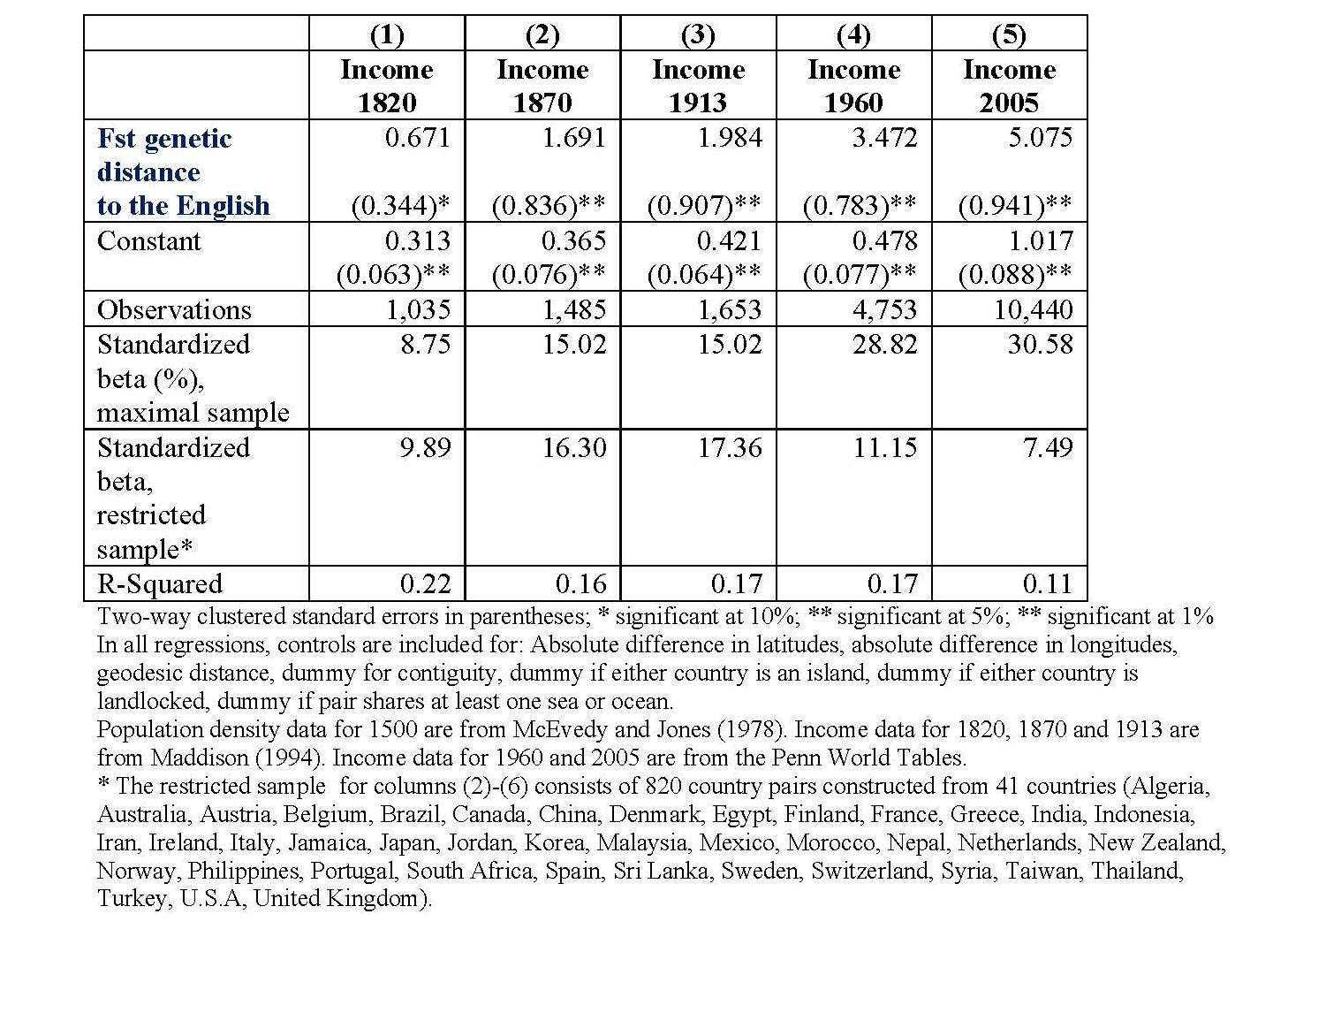
The Diffusion of the Industrial Revolution
(from Spolaore and Wacziarg, in Handbook of Economic Growth)

Slide 10
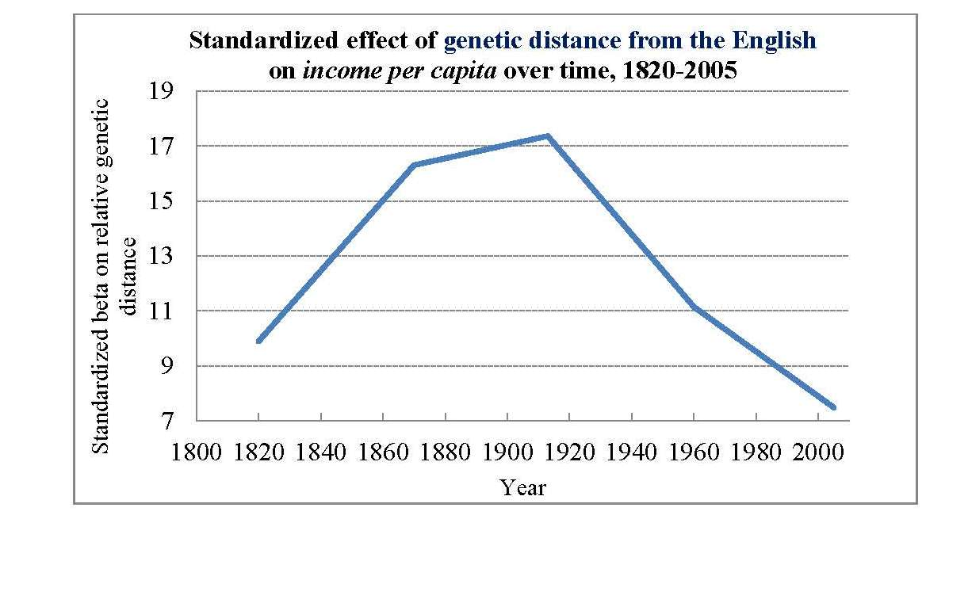
The Diffusion of the Industrial Revolution

Slide 11
A Key Behavioral Innovation:
Reduced Marital Fertility
Fertility decline is not a new phenomenon historically, but in pre-modern times it tended to take place through marriage postponement and/or reduction of fertility outside marriage.
It is only in modern times that most people started to significantly reduce their overall fertility within marriage (e.g., studies in Coale and Cotts Watkins, 1986 – Princeton European Fertility Project).

Slide 12
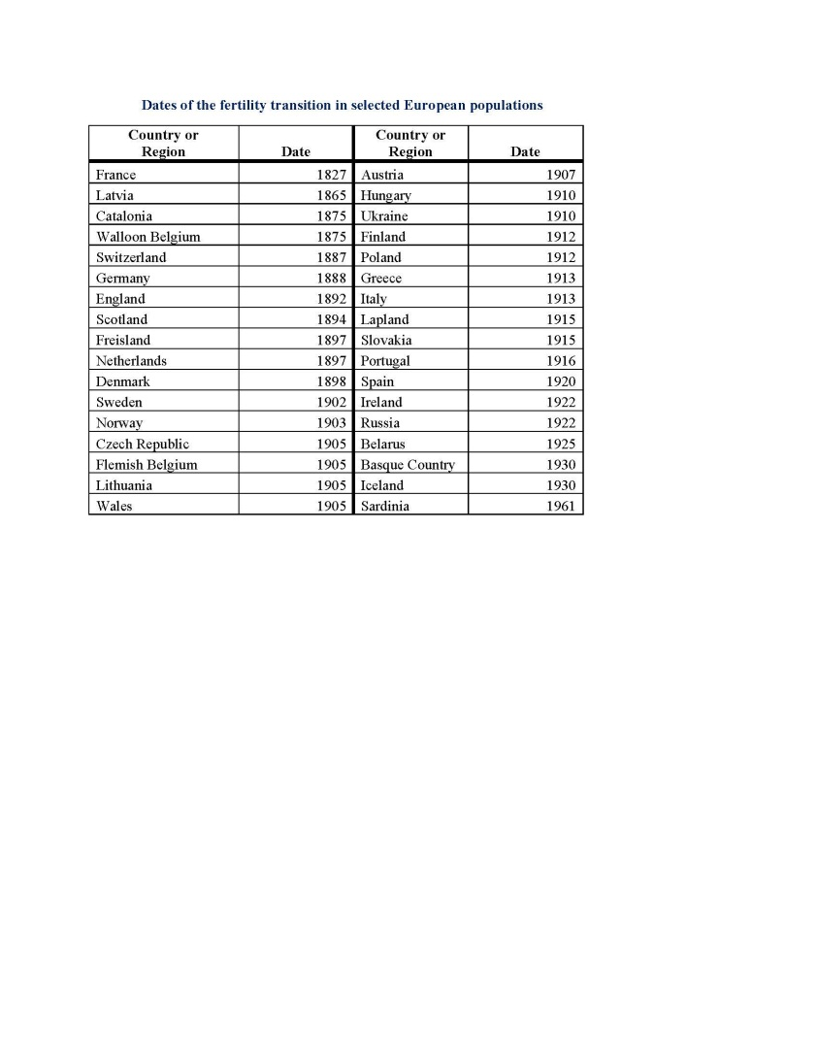

Slide 13
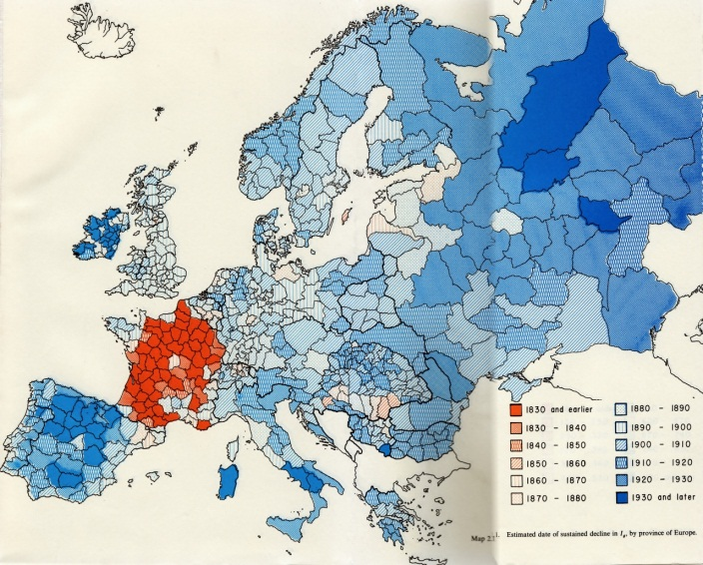

Slide 14
A Tale of Two Diffusions?
Hypothesis 1: The spread of “modernity” involved two separate processes of diffusion
-) The spread of technological innovations associated with the Industrial Revolution, where England played a leading role
-) The spread of social/behavioral changes – such as marital fertility decline - where France played a leading role
Hypothesis 2: The two diffusions followed different patterns, because societies at different relative “ancestral” distances from the innovators faced different barriers to imitation
-) Societies that were relatively “closer” to England faced lower barriers to adopting the innovations associated with the Industrial Revolution (Spolaore and Wacziarg, 2009, 2012, 2013a, 2013b)
-) Societies that were “closer” to France were more likely to adopt the social/behavioral changes pioneered by the French – such as lower marital fertility.

Slide 15
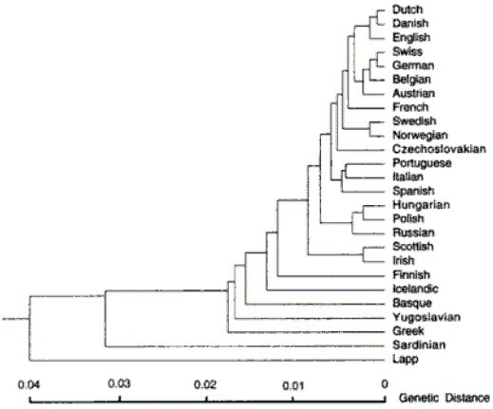

Slide 16
Marital Fertility Decline in Europe
Cross-national regressions for the transition date, focusing on genetic distance from France
 | Univariate | Control for distance | Control for geography | Control for initial income 1820
FST | 0.163 | 0.146 | 0.172 | 0.169
from France | (3.54)*** | (2.78)*** | (2.45)** | (2.00)*
Geodesic Distance to |  | 2.912 | 1.502 | -13.592
France |  | (0.64) | (0.11) | (0.49)
Absolute difference in |  |  | -102.774 | -58.838
latitudes, from France |  |  | (0.90) | (0.39)
Absolute difference in |  |  | 16.311 | 167.189
longitudes, from France |  |  | (0.61) | (0.63)
1 for contiguity with |  |  | -11.448 | -9.273
France |  |  | (1.11) | (0.59)
=1 if an island |  |  | 2.140 | 2.412
 |  |  | (0.13) | (0.08)
=1 if shares at least one |  |  | 12.621 | 24.613
sea or ocean with France |  |  | (1.19) | (1.39)
Average elevation between |  |  | 31.605 | 41.252
countries to France |  |  | (1.26) | (1.34)
Per capita income, 1820, |  |  |  | -0.001
from Maddison |  |  |  | (0.02)
Constant | 1,893.536 | 1,891.221 | 1,881.119 | 1,865.035
 | (426.44)*** | (328.75)*** | (143.30)*** | (38.24)***
# of nations | 36 | 36 | 36 | 26

Slide 17
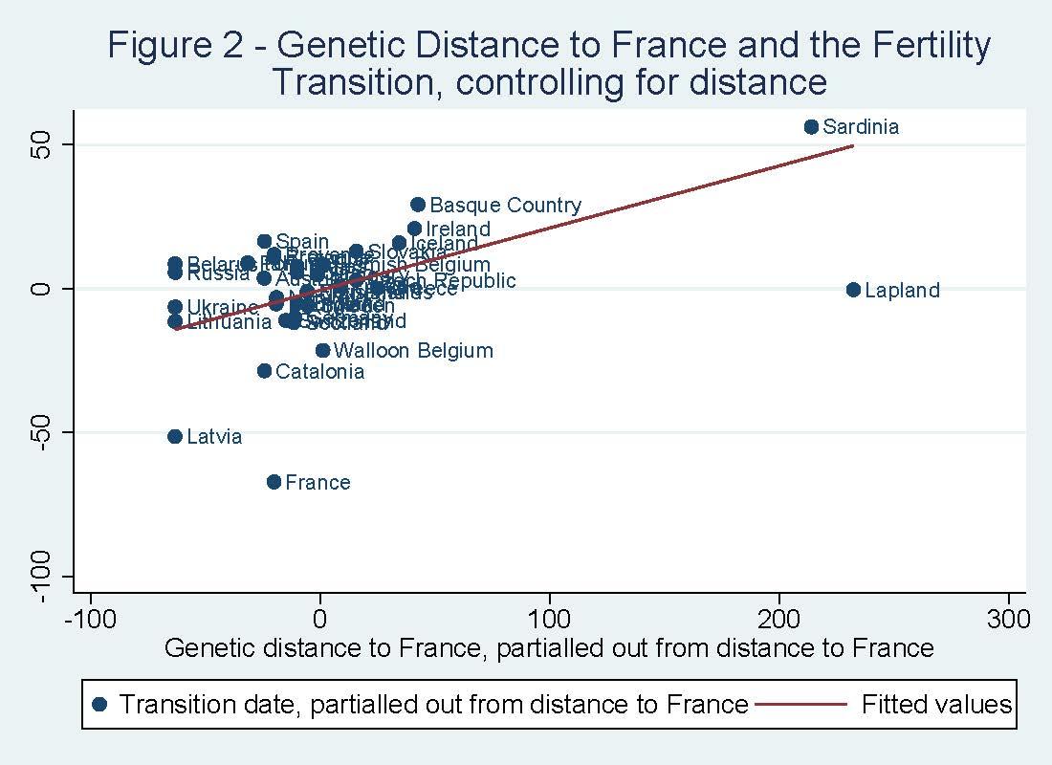

Slide 18
Horserace France vs. England
(Dependent variable: Fertility Transition date)
 | Univariate | Control for distance | Horserace, simple | Horserace, all geo. controls | Horserace, all controls + income 1820
FST | 0.163 | 0.044 | -0.131 | -0.236 | -0.344
from England | (1.77)* | (0.30) | (0.89) | (1.14) | (1.05)
FST |  |  | 0.177 | 0.225 | 0.211
from France |  |  | (3.01)*** | (2.77)** | (1.87)*
Geodesic Distance |  | 7.488 | 18.444 | 94.460 | 67.167
from England |  | (1.01) | (1.27) | (2.01)* | (0.77)
Geodesic Distance |  |  | -10.546 | -73.446 | -76.655
from France |  |  | (0.81) | (1.53) | (1.13)
Per capita income, 1820, |  |  |  |  | -0.008
from Maddison |  |  |  |  | (0.14)
Constant | 1,896.270 | 1,893.332 | 1,889.430 | 1,885.589 | 1,890.393
 | (323.18)*** | (289.02)*** | (311.11)*** | (82.78)*** | (15.86)***
# of countries | 36 | 36 | 36 | 36 | 26

Slide 19
Linguistic Distance
Linguistic Distance from Ethnologue (Gordon)
number of different linguistic nodes between language A and language B
Example:
Linguistic Distance between Paris and Madrid
Indo-European, Italic, Romance, Italo-Western, Western, Gallo-Iberian, Gallo-Romance, Gallo-Rhaetian, Français (Langue d’Oïl)
Indo-European, Italic, Romance, Italo-Western, Western, Gallo-Iberian, Ibero-Romance, West Iberian, Castilian

Slide 20
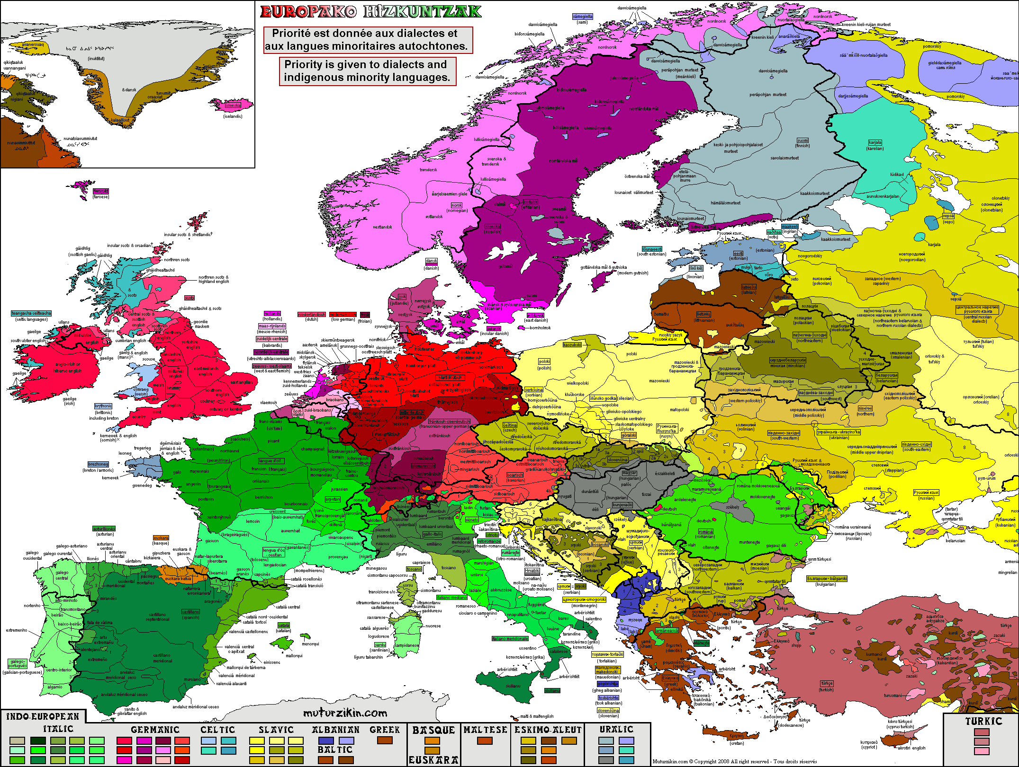

Slide 21
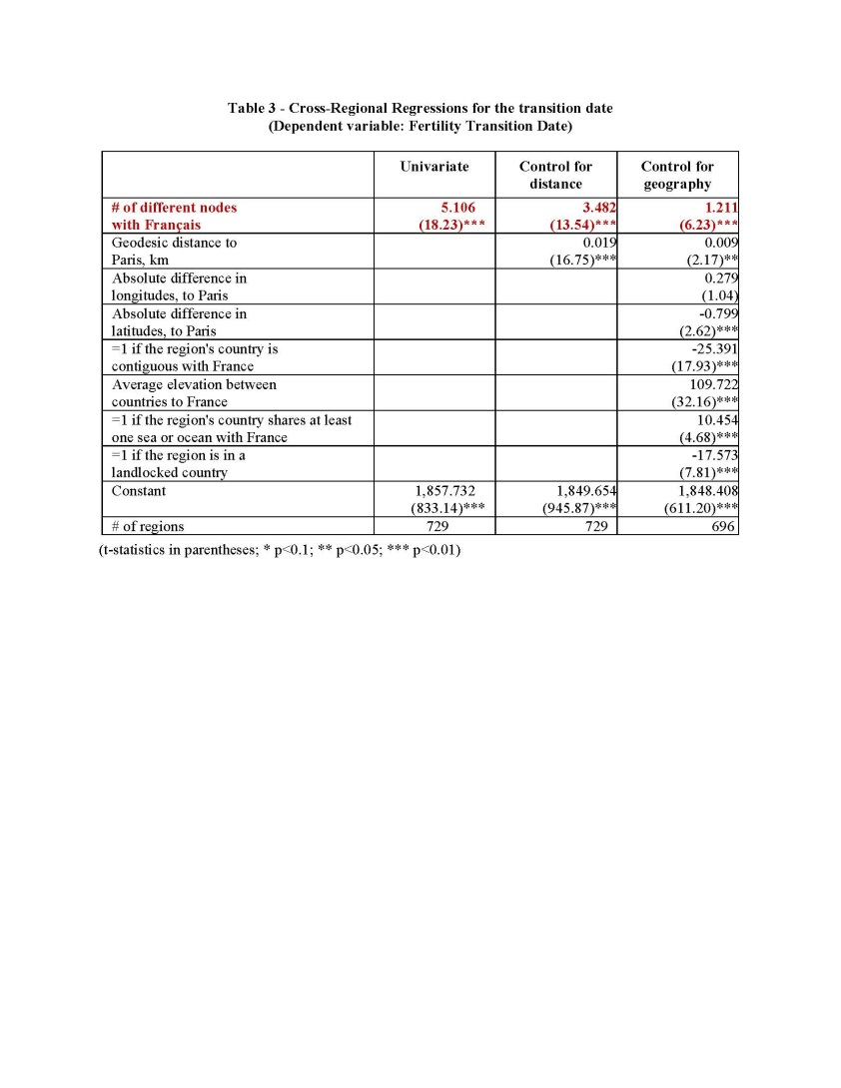

Slide 22
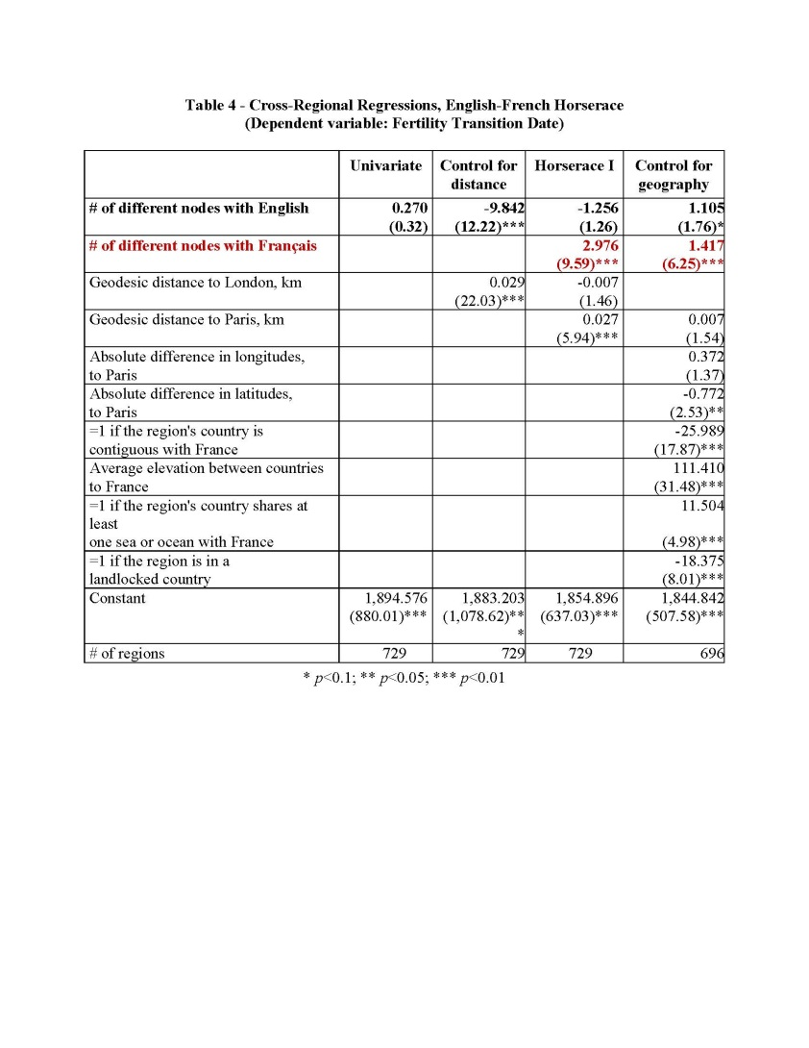

Slide 23
In Conclusion
Diffusion of fertility behavior and diffusion of economic development followed different patterns
The spread of lower marital fertility in Europe is consistent with diffusion from France, with societies closer to the French facing lower initial barriers to the adoption of the novel behavior, even through eventually all European populations adopted the new behavior
Barriers to diffusion seem to be in large part associated with differences in inter-generationally transmitted traits (relative genetic and ancestral linguistic distance)
Big open question: what specific mechanisms?

