Slide 1
Determinants of inequality and intergenerational mobility
Chicago, HCEO working Group
April 18, 2014

Slide 2
Motivations
Relation between inequality and mobility (Great Gatsby curve)
Size of the intergenerational persistence, eg Clark’s recent book. In contrast, in a study of surnames in the Catalonia census, 2001, Guell, Rodriguez Mora and Telmer find:
In a calibration exercise estimating (Informational Content of surnames, Gini (of surnames), number of persons per surname) an intergenerational coefficient for education of 0.6
Assortative mating is large, and has increased in the 20th century

Slide 3
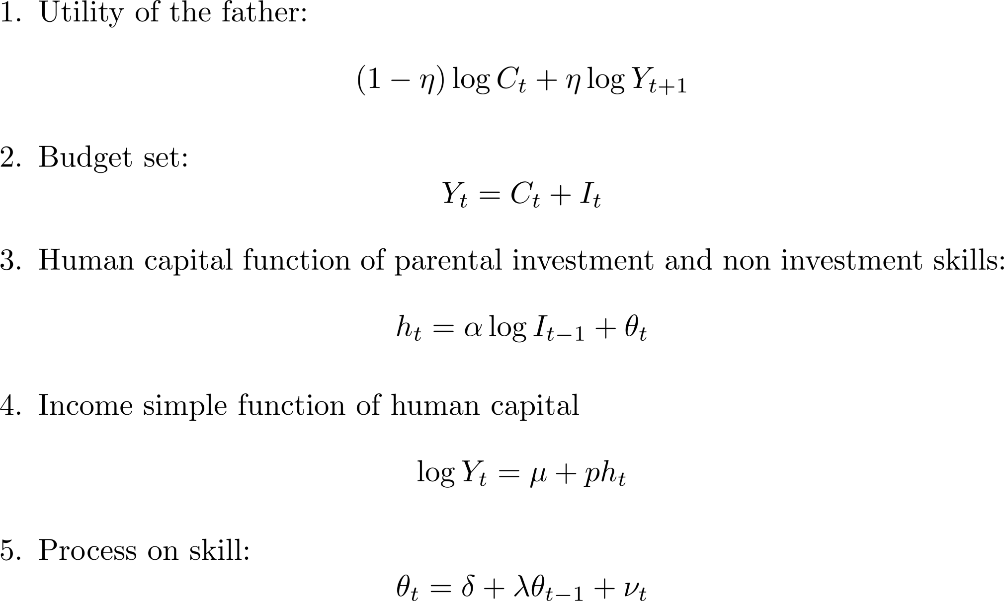
Standard BT Model

Slide 4
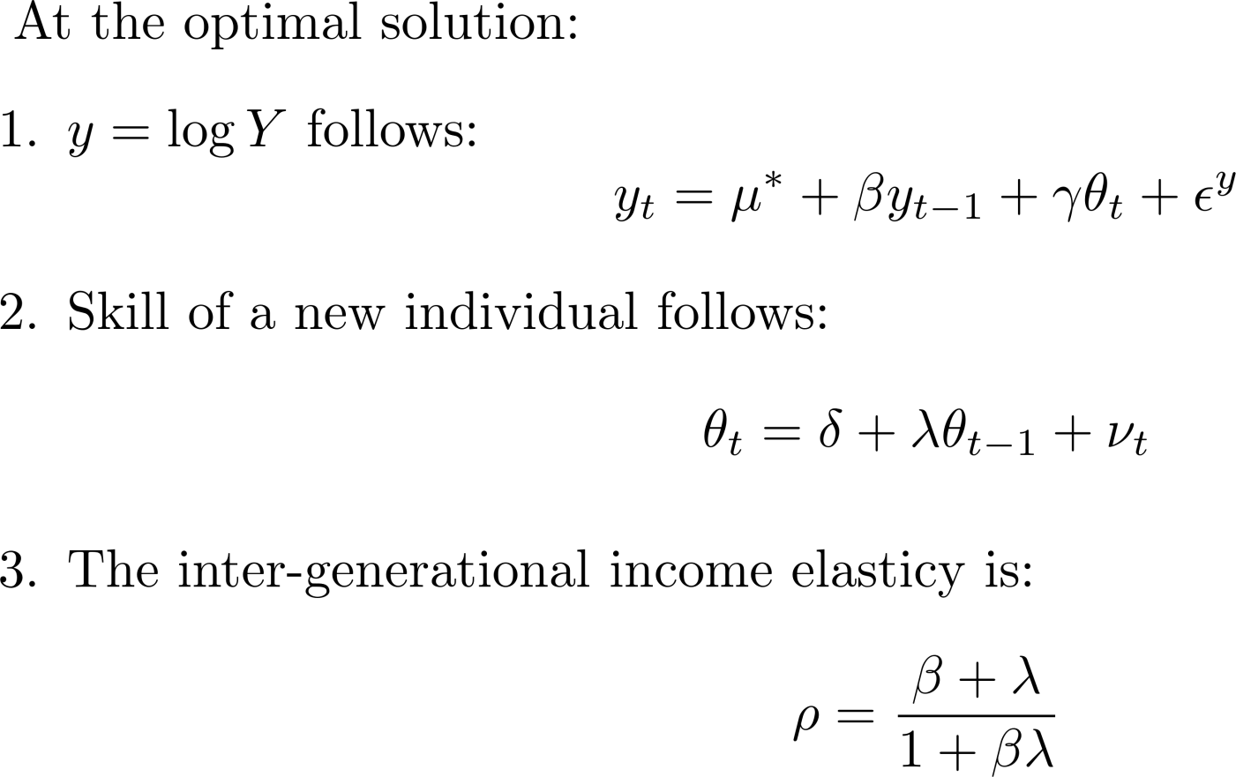
Standard Model

Slide 5
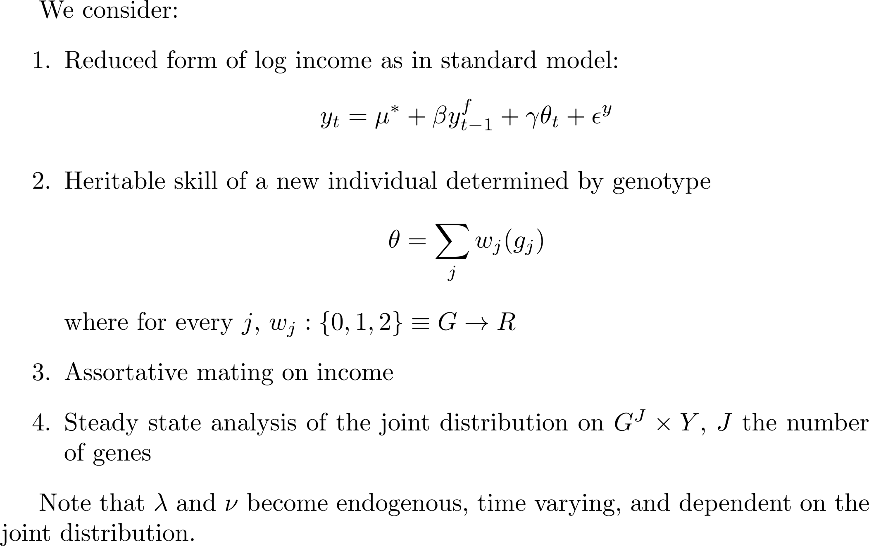
Model

Slide 6
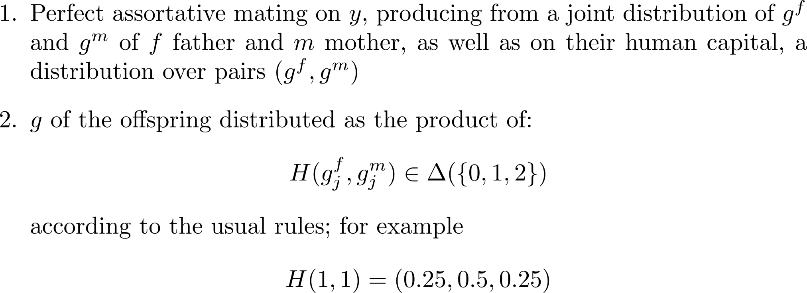
Mating rules

Slide 7
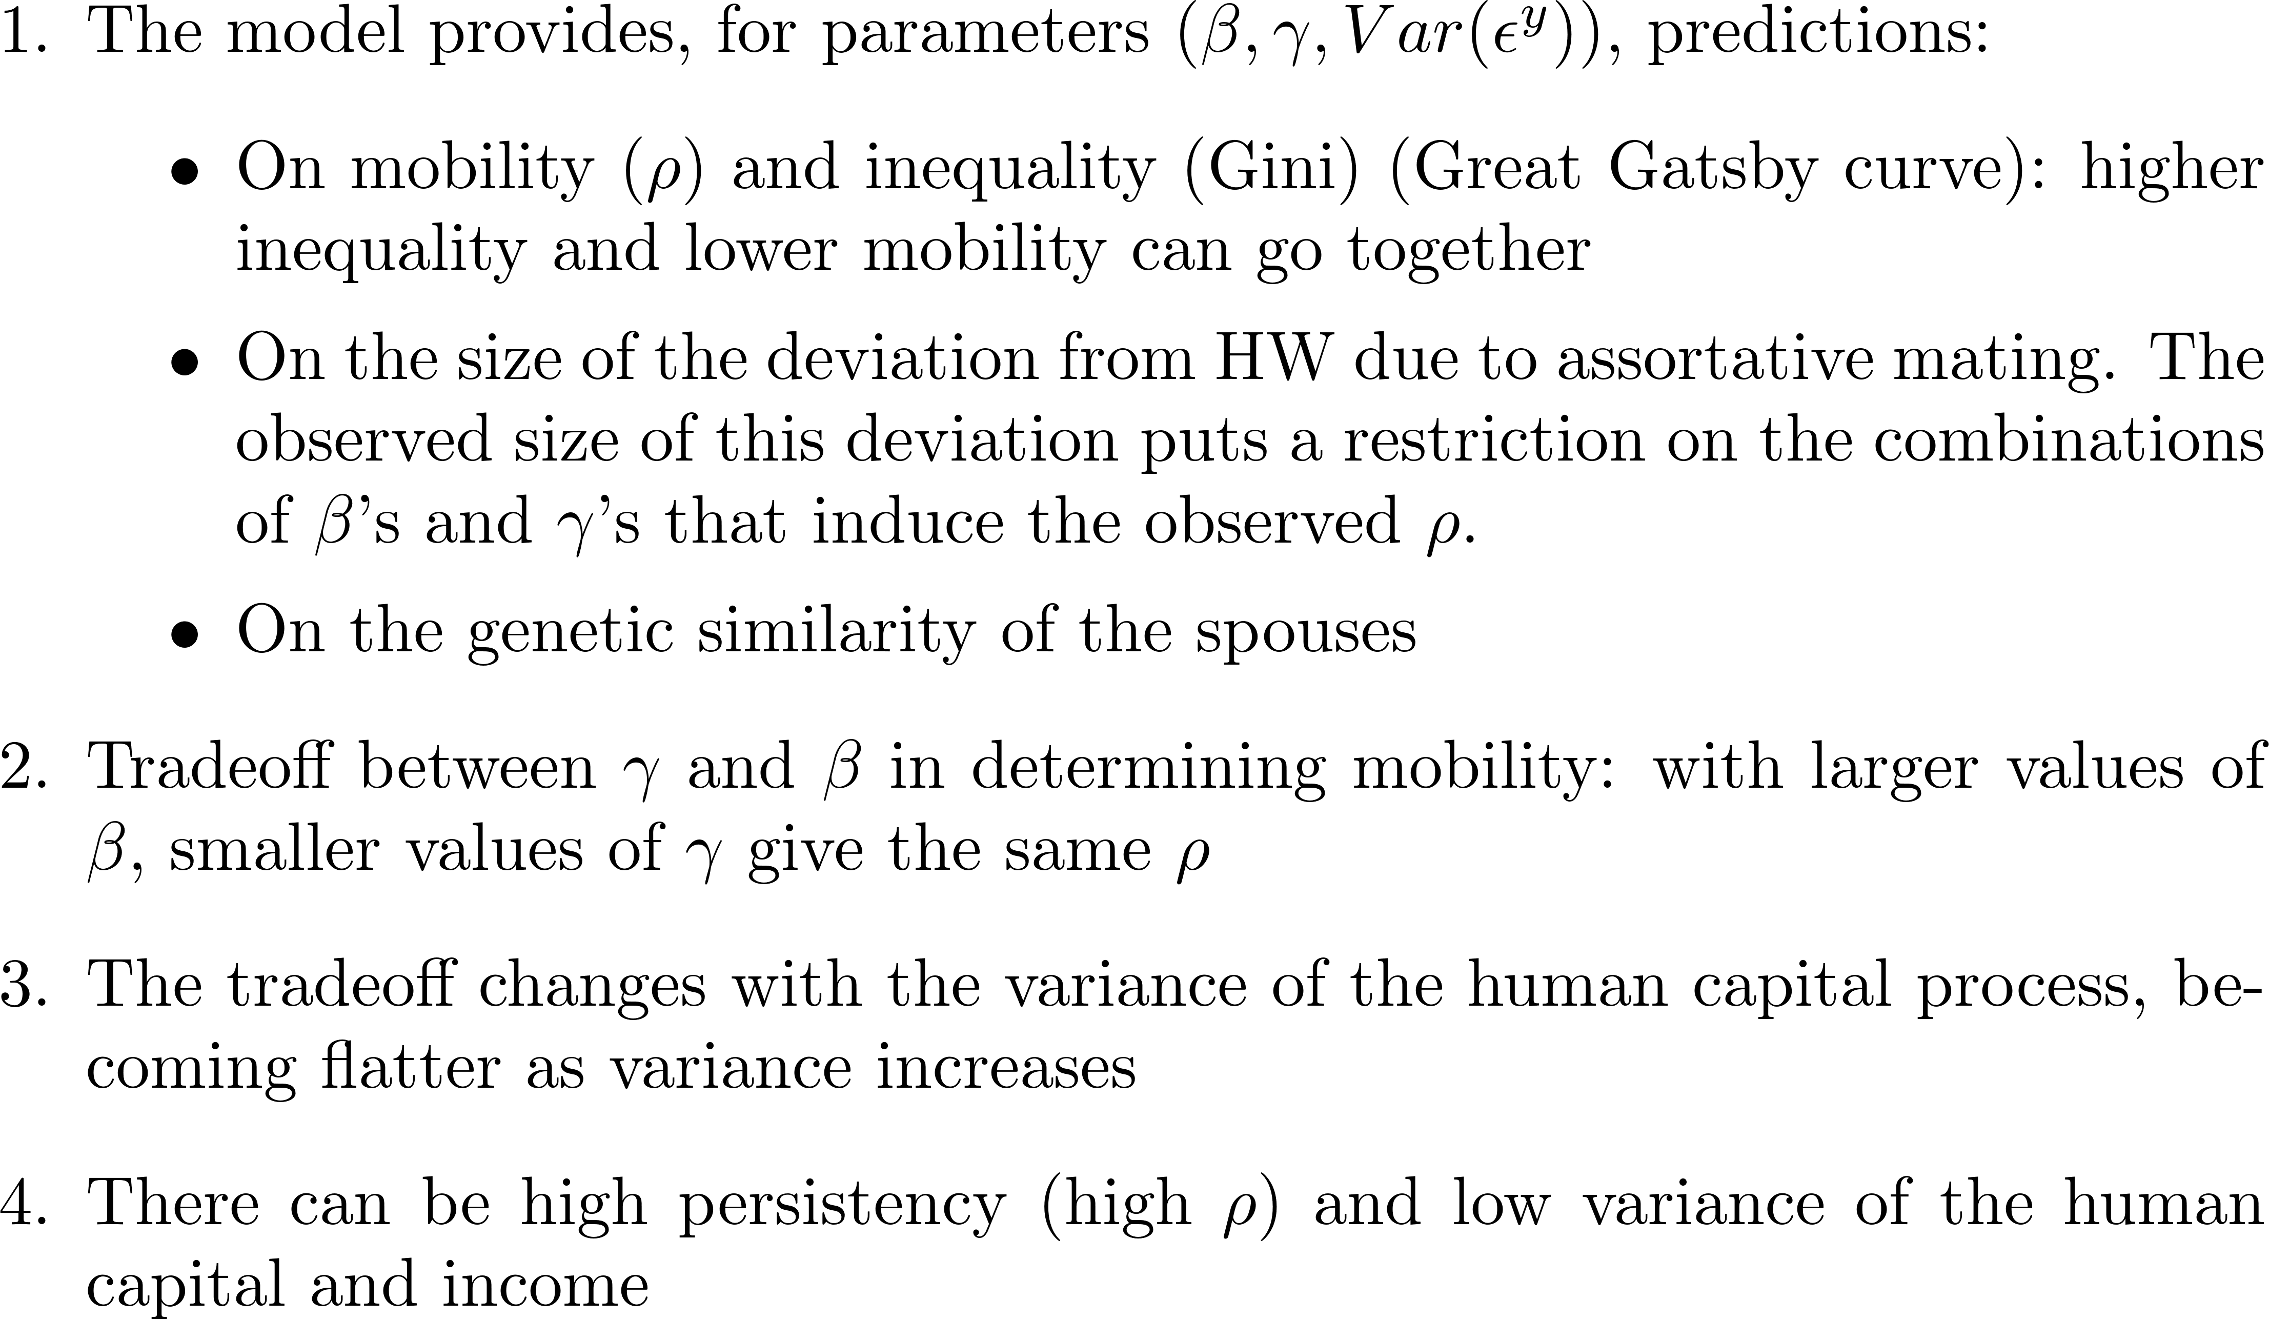
Predictions

Slide 8
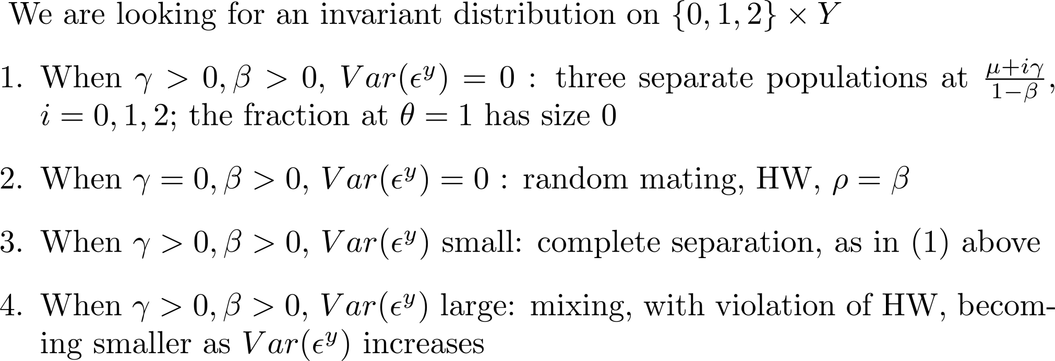
First intuition: Single gene model

Slide 9
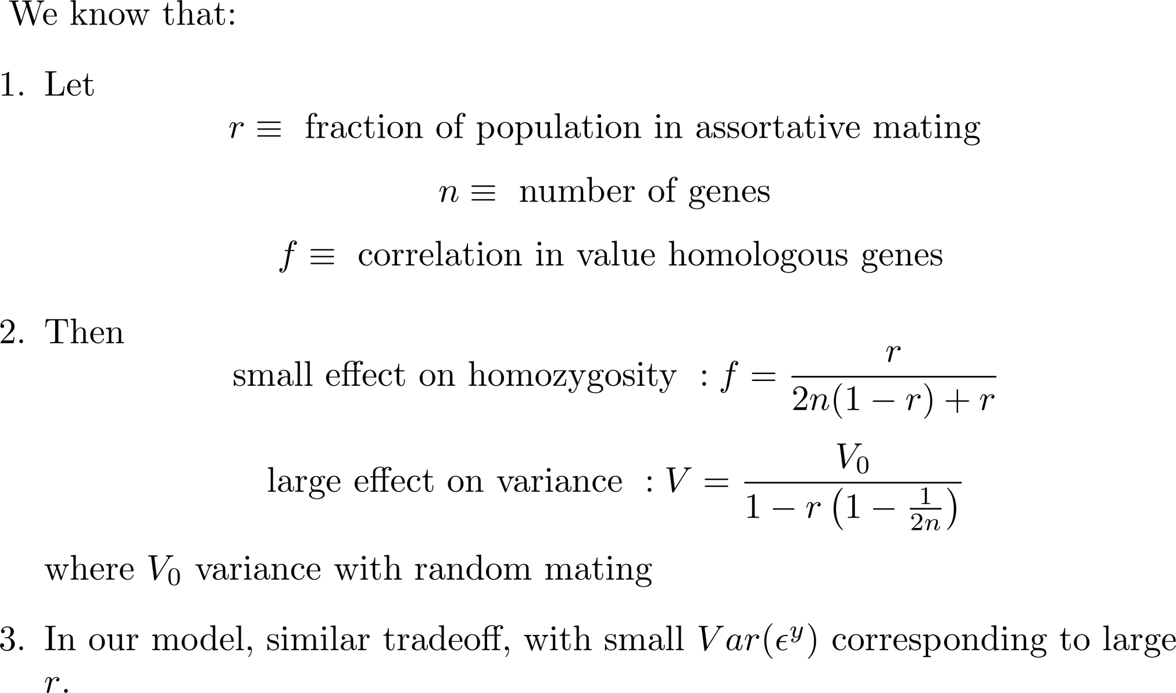
Assortative mating on phenotype

Slide 10
Income distribution
Small number of genes (5), 20 thousand individuals, 100 periods
as variance of income increases
Notes:
Parameters:
F = 10000;
N = 2*F; % number of individuals, an even number
T = 100; % number of periods
G = 5; % number of genes
IncomeRange = 10; % income scale
w = (1/G)*ones(G,1);
p = ones(N,1)*(0.5*ones(1,G));

Slide 11

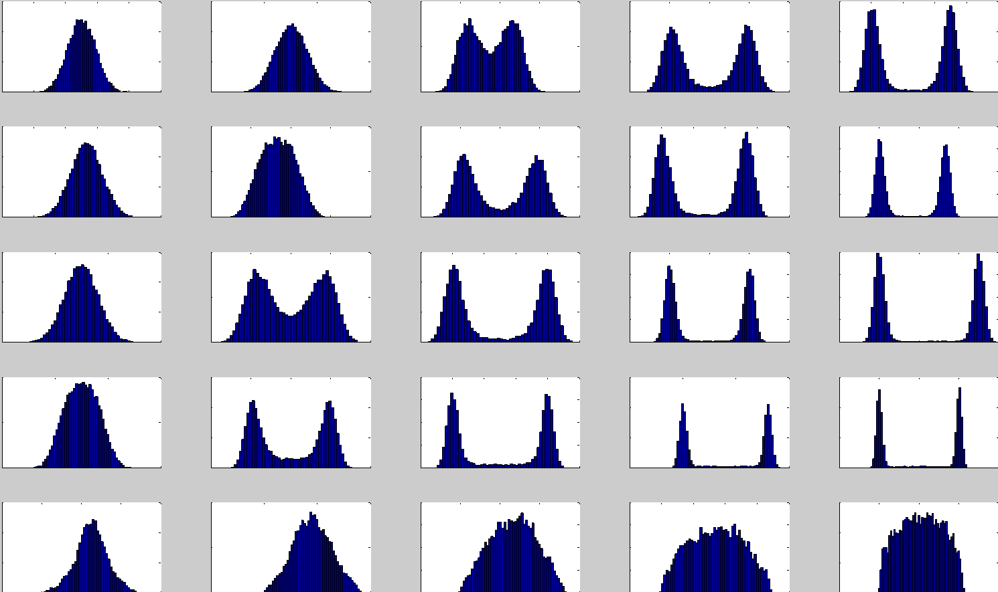


Slide 12
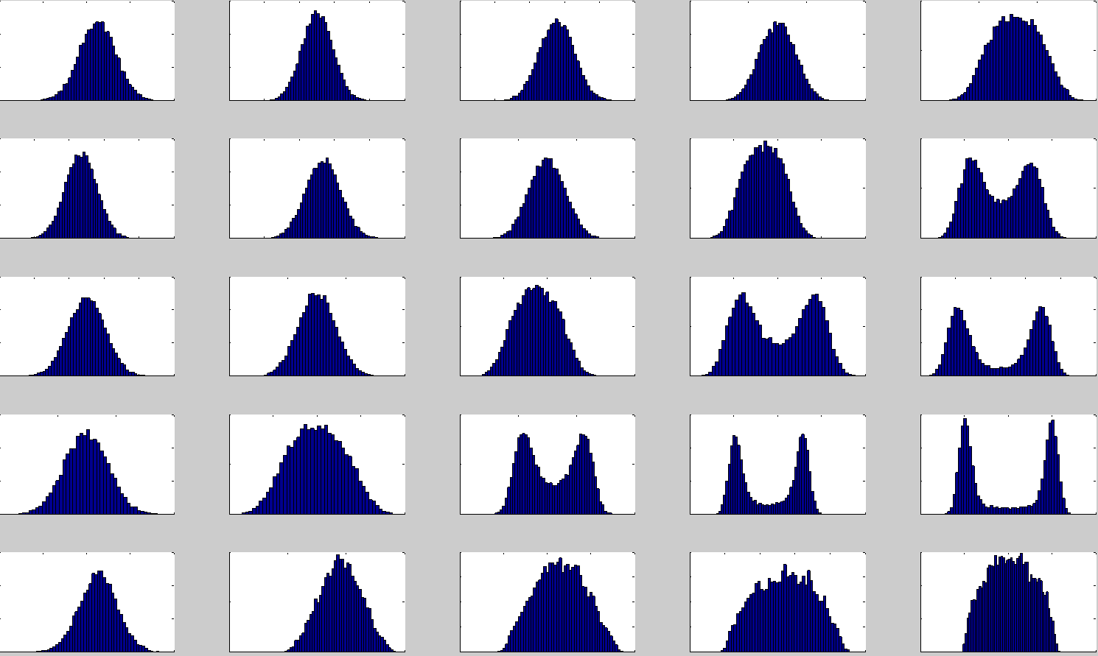

Slide 13
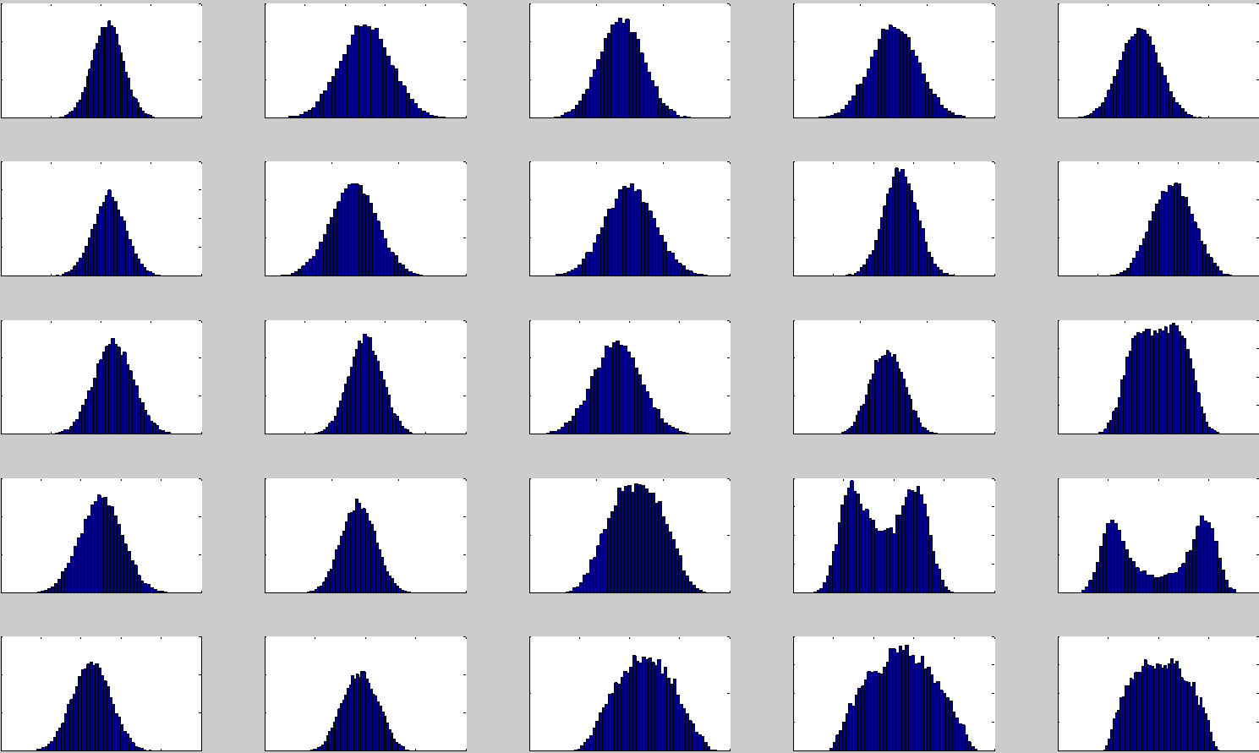

Slide 14
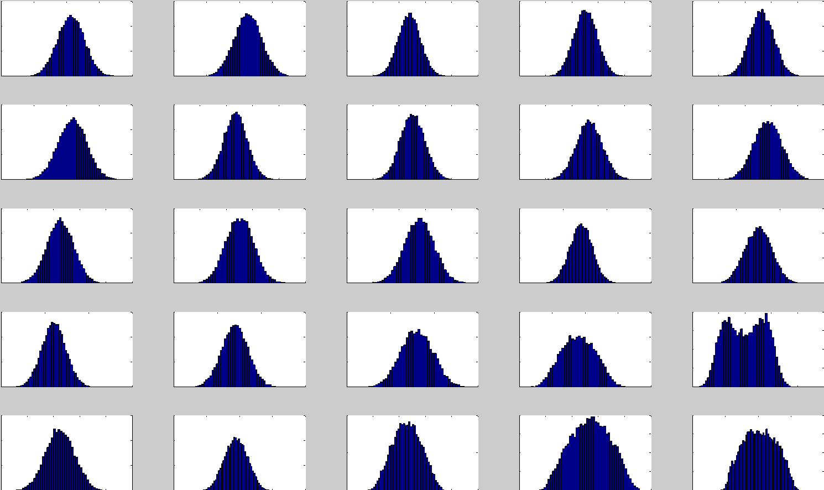

Slide 15
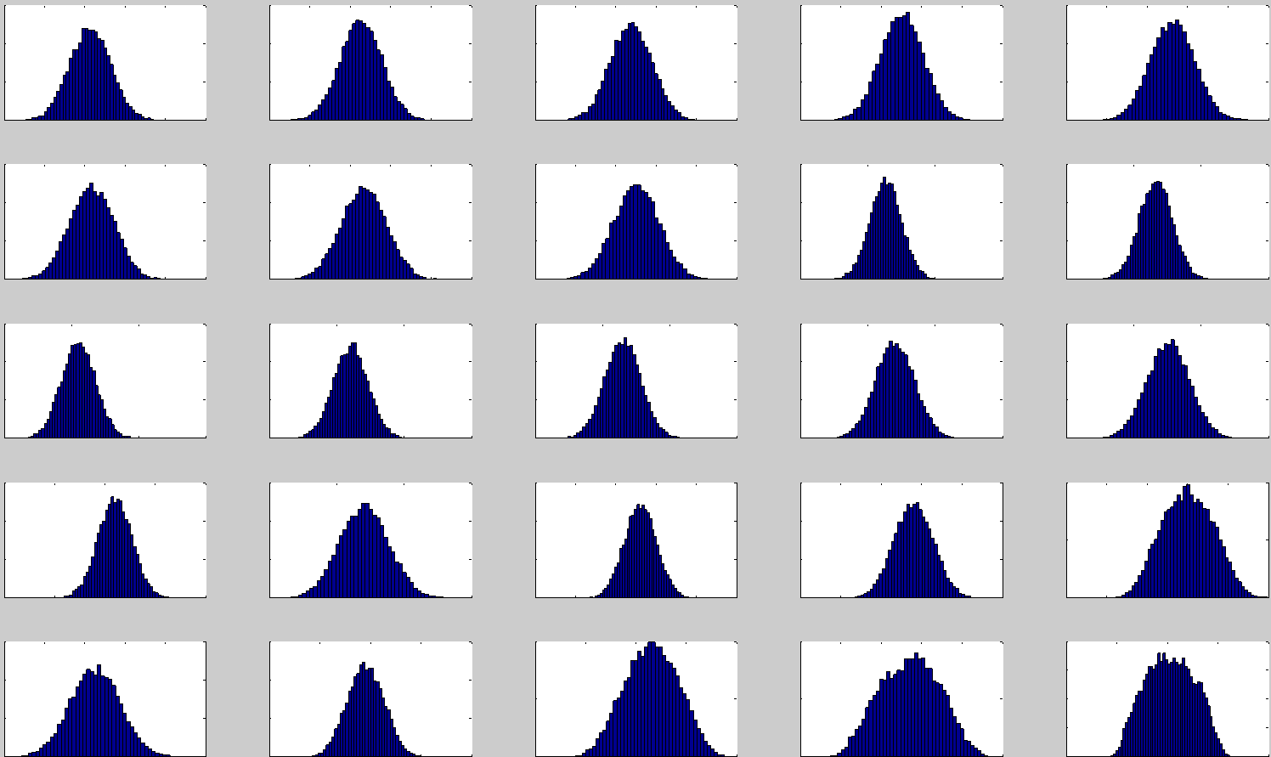

Slide 16
Intergenerational immobility

Slide 19
gamma
Higher variance in income shock
Small variance
beta

Slide 20
inequality

Slide 21
Gini 0.14
Gini 0.33
Gini 0.18
Gini 0.41

Slide 23
Immobility
Gamma Beta | 0.2 | 1
0.2 | 0.30 | 0.97
0.8 | 0.94 | 1.000

Slide 24
Deviations from HW

Slide 25
Deviations from HW

Slide 26
Larger number of genes
Larger number of genes (20), 10 thousand individuals, 100 periods
as variance of income increases
Notes:
Parameters:
F = 5000;
N = 2*F; % number of individuals, an even number
T = 100; % number of periods
G = 20; % number of genes
IncomeRange = 10; % income scale
w = (1/G)*ones(G,1);
p = ones(N,1)*(0.5*ones(1,G));

Slide 27
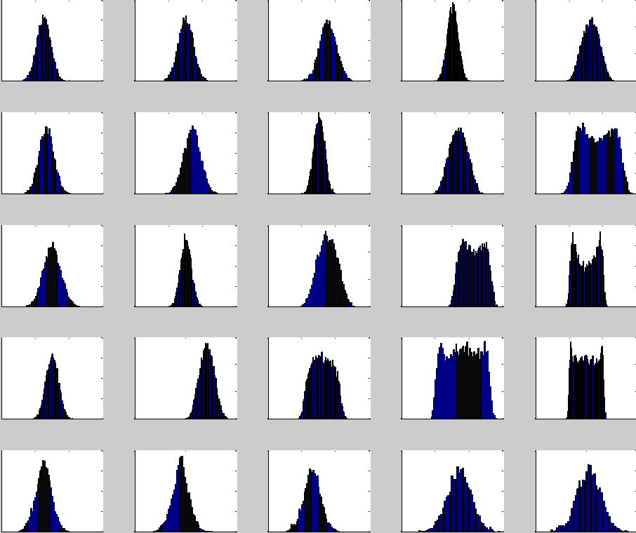

Slide 28
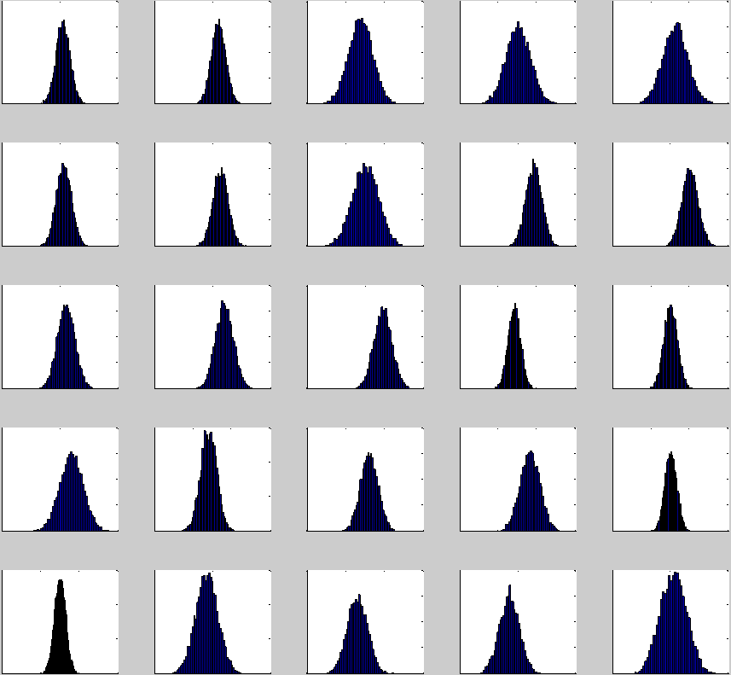

Slide 29
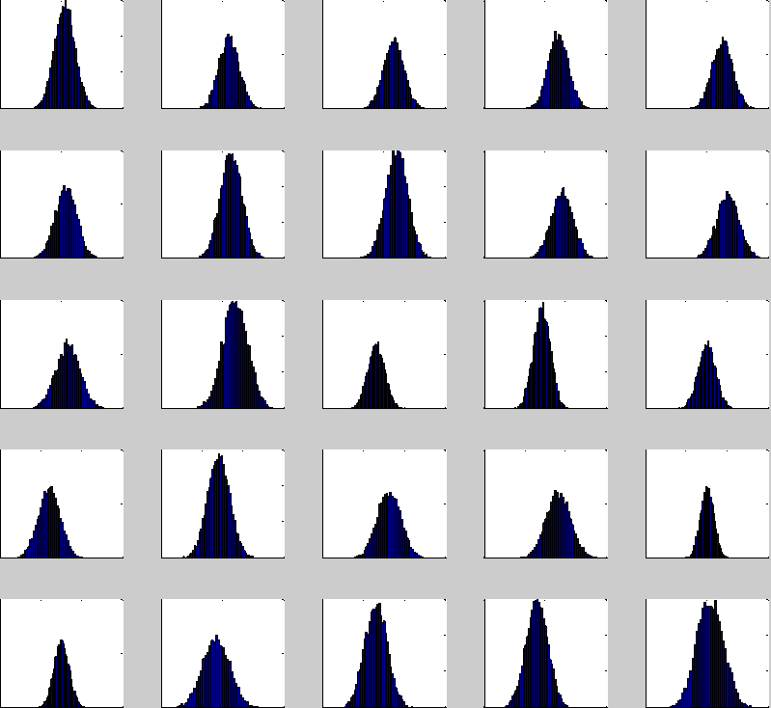

Slide 30
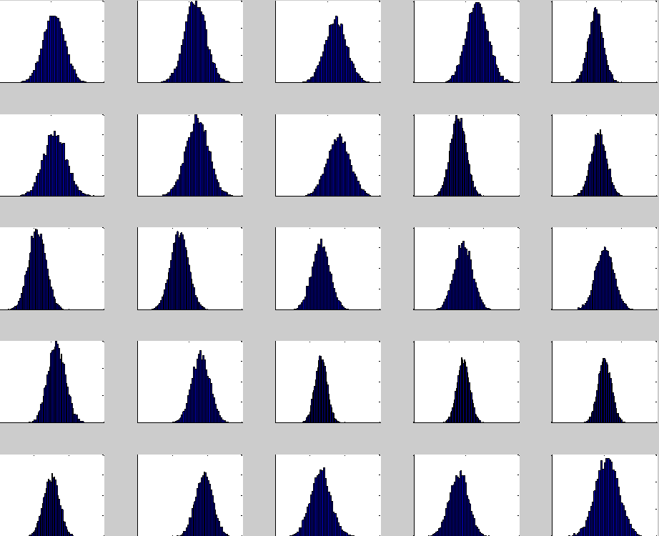

Slide 31
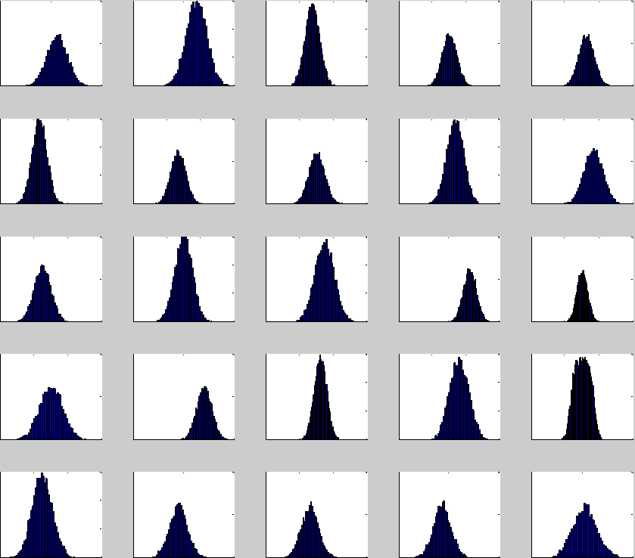

Slide 34
Immobility
Gamma Beta | 0.2 | 1
0.2 | 0.224 | 0.867
0.8 | 0.839 | 1.002

Slide 37
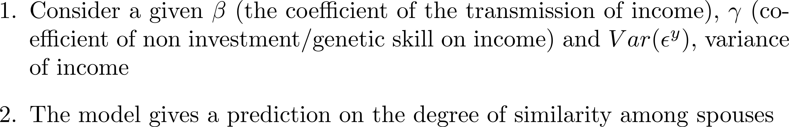
Predictions on the genetic similarity among spouses

Slide 38
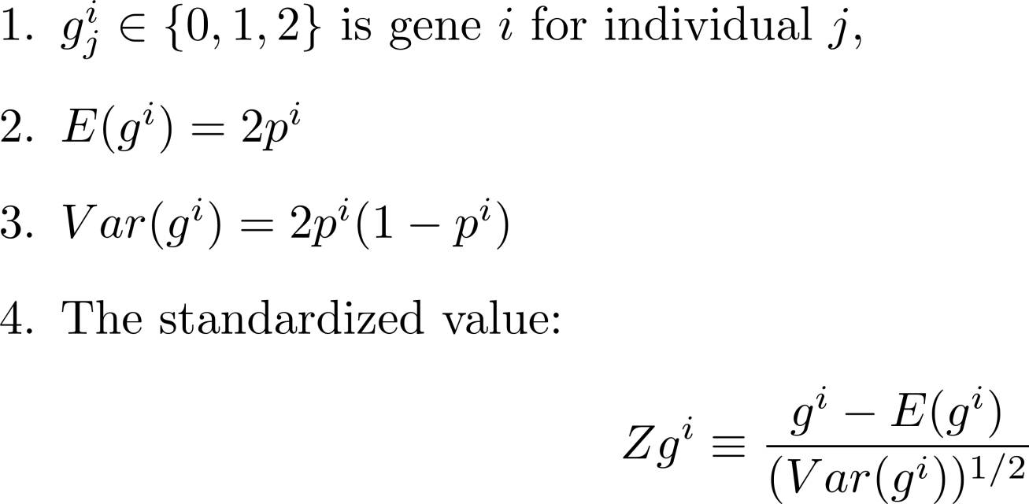
Notation

Slide 39
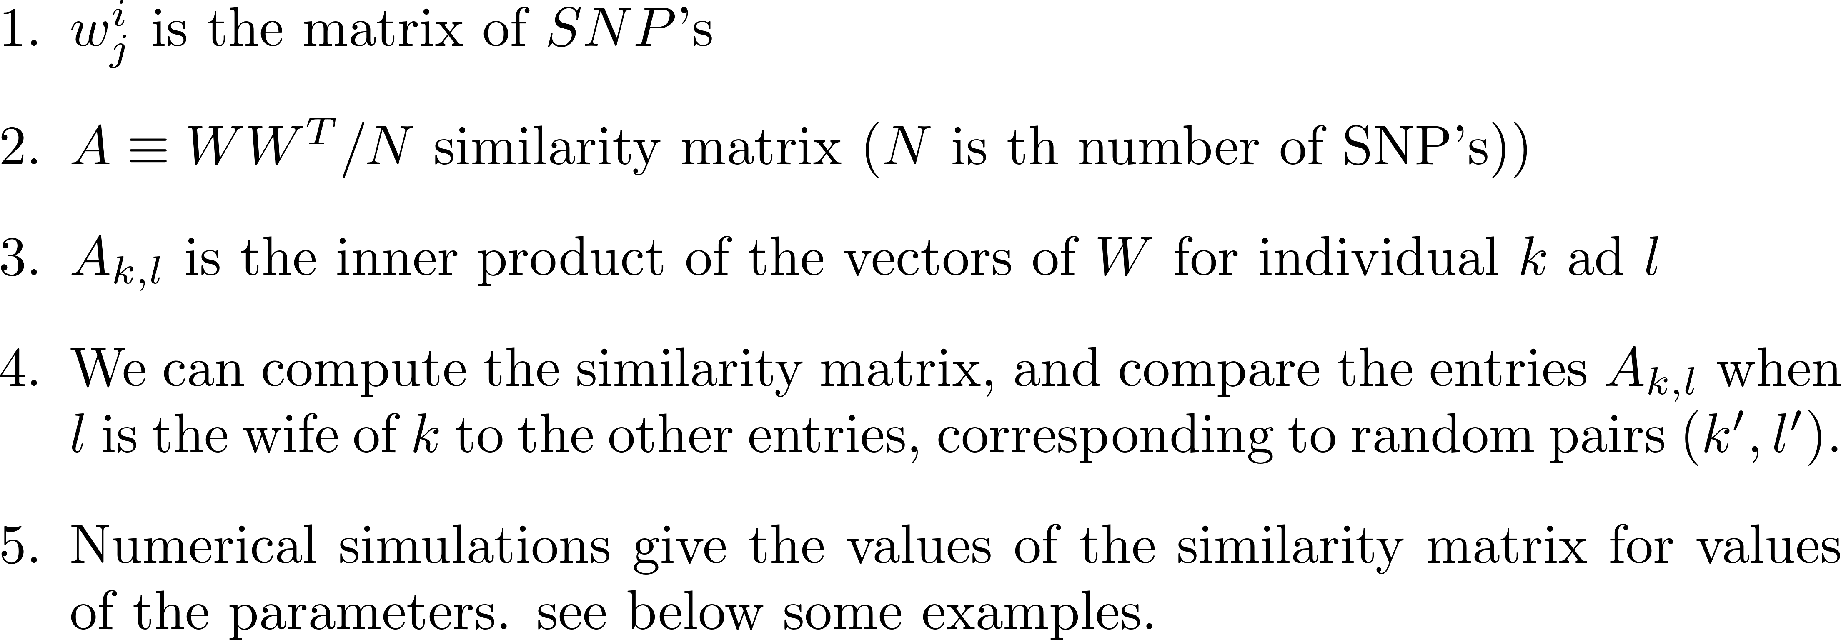
Similarity among individuals

Slide 40
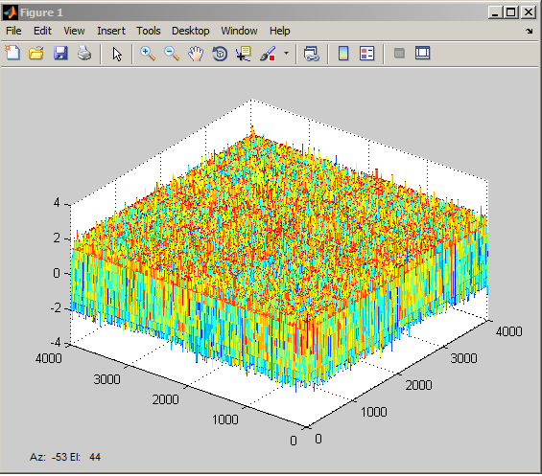
Beta=0.2, gamma=0.2, v = 0.2

Slide 41
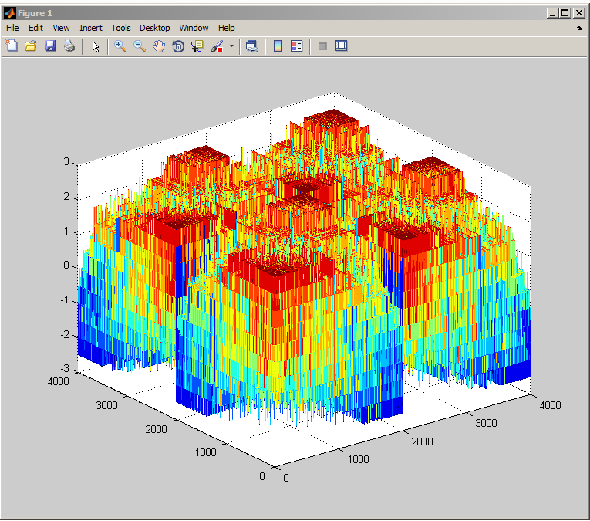
Beta=0.4, gamma=0.4, v = 0.2

Slide 42
Assortative on what?

Slide 43
IQ: r = 0.37

Slide 44
Traditionalism (MPQ) r = 0.43

Slide 45
Control (MQP derived) r = 0.20

Slide 46
Education: polychoric r = 0.777

