Slide 1
Using Genetics To understand Environmental influences
Jenae M. Neiderhiser
Department of Psychology
The Pennsylvania State University
Conference on Genetics and Behavior
HCEO, University of Chicago. April 18-19, 2014

Slide 2
Genotype-environment correlation
Passive: parents & children share genes & share environments
Evocative: the environment (or people in it) respond to genetically influenced characteristics of individuals
Active: individuals seek out environments correlated with their genotype

Slide 3
Mechanisms of Parenting
G_{p}
G_{c}
Passive GE Correlation
Contextual
factors
Evocative GE Correlation
Parent’s
characteristics
Parenting
behavior
Child’s
characteristics

Slide 4
Mechanisms of Parenting
Psychopathology
G_{c}
Contextual
factors
Evocative GE Correlation
G_{p}
Social
support
Parent’s
personality
Parenting
behavior
Child’s
characteristics
Partner relationships
Notes:
This is a rough approximation of a model proposed by Jay Belsky in the late 80s. In this model Jay proposed 3 primary influences on parenting behaviors, with contextual factors including things like SES, marital relationship quality, etc. The two most relevant to understanding rGE are parent’s characteristics and child’s characteristics. Specifically, if parents there are genetic influences on parent’s characteristics that then influence the way they parent, passive rGE is suggested, while if there are genetic influences on child’s characteristics that influence the way they are parented, evocative rGE is indicated. In the next set of analyses I will describe how we attempt to tease apart these different influences using a paired set of research studies focused on chidlren who vary in degree of genetic relatedness and parents who are twins.
4

Slide 5
Children Of Twins Design (conceptual)
1.0 MZ; .5 DZ
Spouse 1 (Parent)
Twin 1 (Parent)
Twin 2 (Parent)
Spouse 2 (Parent)
.5 MZ parents; .25 DZ parents
.5
.5
.5
.5
Child 1
Child 2
.25 MZ parents; .125 DZ parents

Slide 6
Twin Parents sample
Twin Children sample

Slide 7
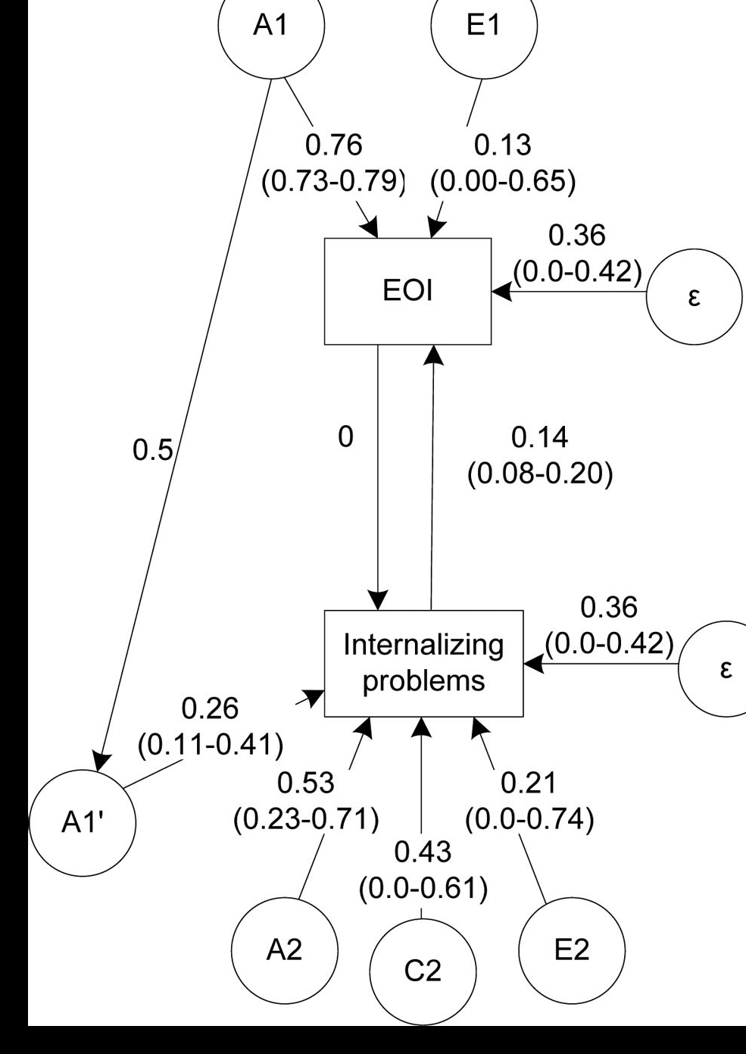
Findings from ECoT
Narusyte et al 2008:
Mother reports of maternal overinvolvement & adolescent internalizing problems
Significant EVOCATIVE rGE
Narusyte et al 2011:
Parental criticism and adolescent externalizing problems
evocative GE correlation for mothers
Direct environmental influences only for fathers
Marceau et al 2014:
Parental negativity and adolescent externalizing problems
Evocative rGE for mothers & fathers
Marceau et al under review:
Parental monitoring and adolescent externalizing problems
No rGE – direct enviornmental influences
Horwitz et al under review:
Parental criticism and adolescent somatic symptoms
direct enviornmental influences

Slide 8
Longitudinal Extended Children of Twins
A1
C1
E1
A1
C1
E1
A1
C1
E1
A1
C1
E1
Parenting Twin 1
Parenting Twin 2
Parenting Twin 1
Parenting Twin 2
Child Beh Twin 1
Child Beh Twin 2
Child Beh Twin 1
Child Beh Twin 2
A1’
A1’
A1’
A1’
A2
C2
E2
A2
C2
E2
A2
C2
E2
A2
C2
E2
Time 1
Time 2

Slide 9
Cross-Lagged Extended Children of Twins
A1
C1
E1
E1
C1
A1
Parenting Time 1
Parenting Time 2
Child Beh Time 1
Child Beh Time 2
A1’
A1’
A2
C2
E2
E2
C2
A2
Time 1
Time 2

Slide 10
Biological Parent-Child Designs
Biological
Mother
Biological
Father
Prenatal
influences
Shared environmental influences
Child
Genetic influences
Notes:
Why important? Setting aside the common use of genetically-informed designs to determine percent of variance accounted for by genetic factors-- designs that allow separation of prenatal, genetic, env influences can provide specificity about risk processes to target for intervention. Eg, risks run in families (g + pre+ post E). if see an assoc between family env and child outcome in bio family design, this assoc could be due to pre, genetic, of environmental reasons. In adoption design, can separate the cause of this assoc to be prenatal, g, or E. if for ex prenatal--- target interventions during pregnancy. If G, identify environmental moderators.

Slide 11
Adoptive Parent-Child Designs
Biological
Mother
Biological
Father
Adoptive
Mother
Adoptive
Father
Prenatal
influences
Child
Shared environmental influences
Genetic influences

Slide 12
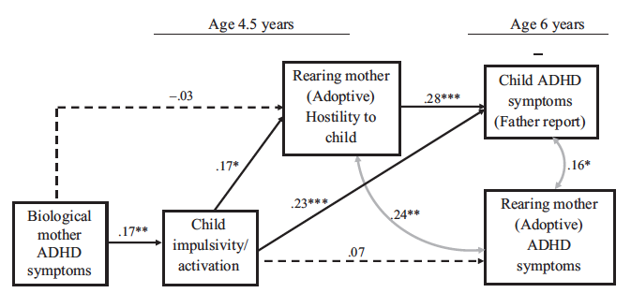
Evocative rGE and Parenting
(Harold et al., 2013)

Slide 13
Evocative rGE and Peers
Mother-Ch
Hostility
.17**
.12*
Preschool Disruptive Peer
Behavior (Mom)
.28***
Birth Mother
Underarousal
.15*
Toddler
Inattention
.17**
.14*
.39***
.29***
Preschool Disruptive Peer
Behavior (Dad)
Father-Ch
Hostility
.26***
χ² (2) = .156, RMSEA =.00
Significant indirect effects:
Birth mother underarousal→ toddler inattention→ mother-to-child hostility (β =.04)
Birth mother underarousal→ toddler inattention→ father-to-child hostility (β =.04)
Toddler inattention→ mother-to-child hostility→ disruptive peer behavior (β =.05)
Toddler inattention→ father-to-child hostility→ disruptive peer behavior (β =.08)
(Elam et al., 2014)

Slide 14
Conclusions
Genetically informed studies need to include detailed measurement of family environment
Including prenatal environment
Children influence the environments they experience via (in part) their genes
Parents’ genes also influence the environments they provide
Using a variety of genetically informed designs allows mechanisms/processes to be clarified

