Slide 1
How to Measure All the Things …and So Much Less
Jonathan W. King Division of Behavioral and Social Research, NIA
(Opinions are my own and not those of NIA, NIH, or the Department of Health and Human Services)

Slide 2
What is Self-regulation?
(Images from www.igniter.com; this is not the Stanford study)

Slide 3
Varieties of Self-Regulation
Impulsivity
Delay discounting
Conscientiousness
Reward sensitivity
Will-power
Inhibition
Self-regulation
Self-monitoring
Executive attention
Effortful control
Self-control
Stress reactivity
Emotion regulation
Notes:
How do we address this challenge? Understanding self-regulation – and ultimately intervening to improve it– requires a better conceptualization of its component processes. A diverse range of constructs have been proposed in the psychological, economic and neuroscience literature that capture key processes involved in self-regulation, but the links between these constructs are not clearly mapped, and the extent to which they index common, distinct or overlapping processes is unknown.

Slide 4
FTO: From T2D to BMI to Eating
FTO in humans affects eating behavior (energy intake): carriers of AA genotype at rs9939609 eat ~280 kcal/day more than those with TT genotype.
Those with AT genotype weigh 1.2 kg more than those with TT; those with AA genotype weigh 3.0 kg more (Frayling et al., 2007).
BUT FTO is also associated with changes in verbal fluency (Benedict et al., 2011) and reductions in brain volume in aging (Ho et al., 2010).
One marshmallow (7 g) contains ~23 kcal.

Slide 5
Health and Retirement Study (HRS) GWAS
Nationally representative, population based sample of those 50+ (and spouses) beginning in 1992 measured biennially.
Very rich data on longitudinal behavioral and social variables, plus administrative linkages to SSA and CMS data.
Genotyping of 12,507 participants for 2.5M SNPs available at dbGaP now; data from ~7,000 additional participants and Illumina exome chip data on the whole sample by the end of 2014.
HRS GWAS data can be used not only in the context of larger consortia for discovery and replication, but also for determination of heritability of traits in the US population (see Yang et al. 2010), studies requiring selection by genotype, and studies that can exploit the full genetic diversity of the US population.
Notes:
Largest, most representative longitudinal study of Americans 50 years & older, with a baseline interview that began in 1992. Parallel ELSA study is also currently being genotyped on the same platform.
Respondents receive follow-up interviews at two year intervals, with a sample size of 20,000 people per biennial interview, and HRS respondents, who at baseline were community-dwelling, are followed if they move into nursing homes or other group residences.
Produced 9 waves of pub avail data & is in process of collecting 10th wave of data under current award.
The HRS is on a 6 year grant cycle which allows for 3 waves of data collection per project period.
And in order to keep N representative of Americans over age 50, new six-year cohorts are added every 6 years & these cohorts are identified from population screenings done every 12 years.

Slide 6
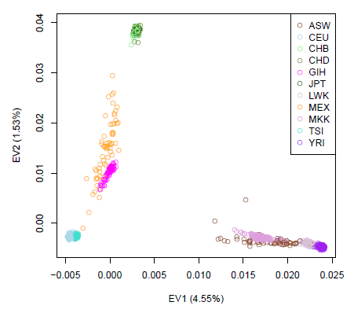
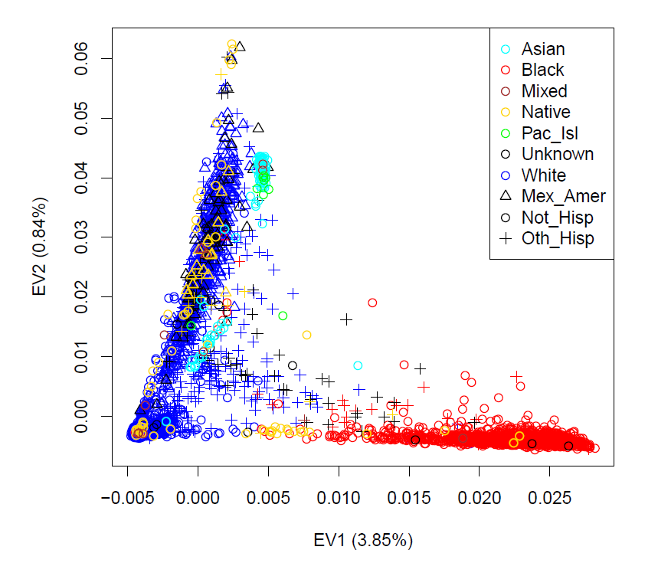
Population Structure of the US (50+) (Scatter plot of first two principal components)
HapMap Controls (N=1230)
HRS Participants (N=12,507)
HRS GWAS data will help us better understand the contribution of genetic variation to health and well-being in a truly representative sample. Advances in analytical techniques may be required to exploit this resource to its fullest.

Slide 7
Cognitive Measures in HRS that Matter
Mental Status:
What is today’s date?
Backwards Counting from 20
Serial 7s (subtract 7 from 100…repeat 4 times)
“What do you usually use to cut paper?
“What do you call the kind of prickly plant that
grows in the desert?”
“Name the current president” Episodic Memory:
Immediate recall (10 word list)
Delayed recall (same 10 word list)

Slide 8
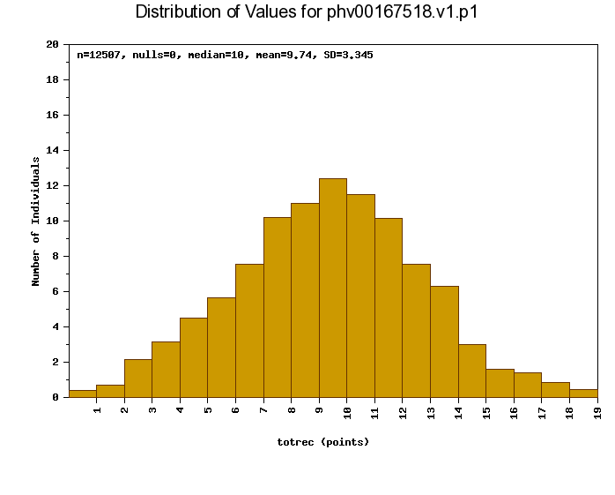
HRS Episodic Memory Total
N= 12,507; as retrieved from dbGaP

Slide 9
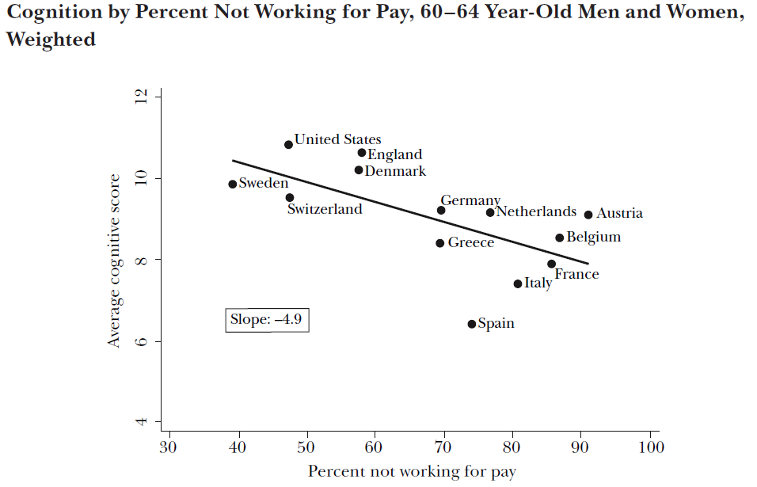
Mental Retirement?
Rohwedder and Willis (2010)

Slide 10
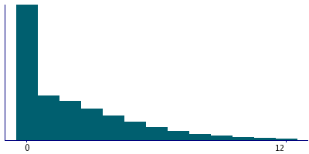
UK BioBank “Pairs” Memory Data (number of errors)
Decile 9 | 6
Decile 8 | 4
Decile 7 | 3
Decile 6 | 2
Median | 1
Decile 4 | 1
Decile 3 | 0
Decile 2 | 0
Decile 1 | 0
Minimum | 0
N=498,709; over 30% of participants received perfect scores, limiting explainable variation.

Slide 11
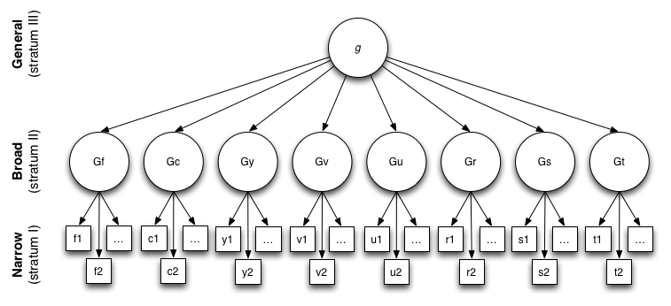
Carroll Three Stratum Model of Cognition
“Composite” Cognitive ability (g) captures nine Broad and dozens of Narrow abilities. (Conceptual model by Carroll, 1993; figure from wikipedia.org)

Slide 12
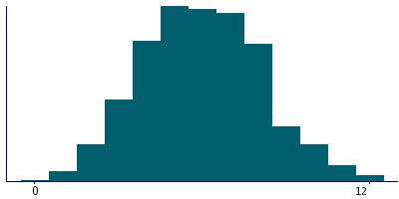
BioBank Fluid Intelligence
N = 165,645. Fluid Intelligence includes 13 items including a synonym item, an antonym item, number series items, and other brief measures.

Slide 13
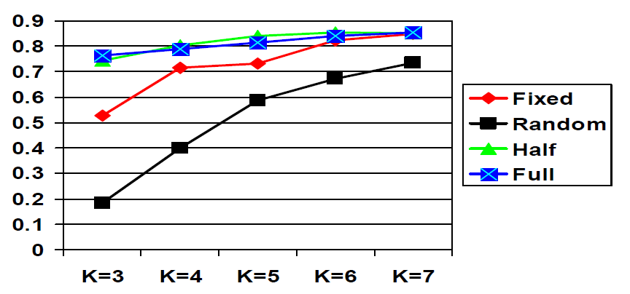
HRS Number Series task now uses 6 (and not 47) items.
The “Half Adaptive” Number series task now takes one eighth of the time to administer, can be given by phone, does not require the administrator to use a computer, and measures the same construct as the “classical” version.

Slide 14
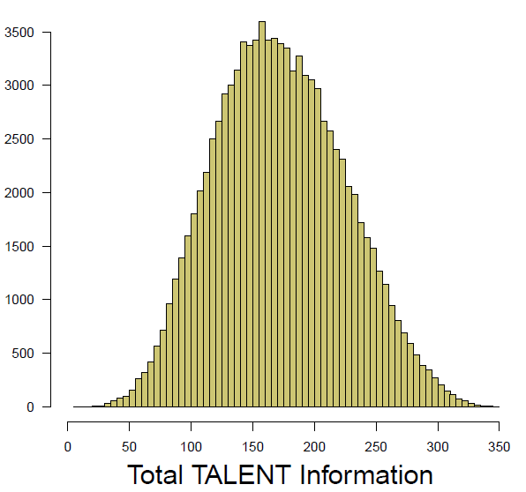
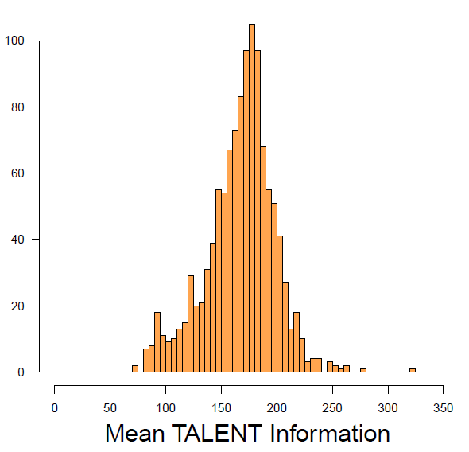
9th Grade Information Data (N=103,893 Ninth graders; N=1173 Schools)
Student Level Data
School Level Data
“School” accounts for approximately 35% of the variance in Project TALENT data.

Slide 15
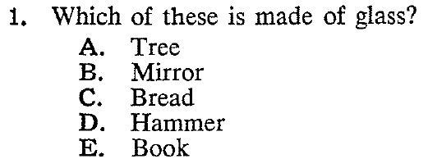
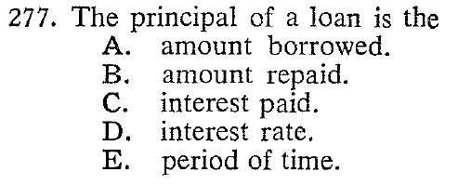
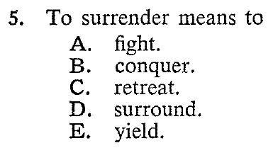
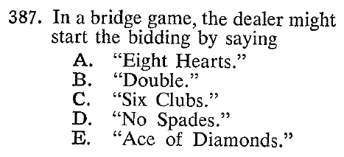
G^{c}: Information / Vocabulary

Slide 16
(Endo)phenotypes (From genetic epidemiology of psychiatric disorders)
Prepulse Inhibition: startle response (e.g., a blink elicited by a loud sound) is inhibited by a prepulse (e.g., a quieter sound 100 ms earlier). [Schematic from www.wikipedia.org]
Smooth Pursuit EMs: Normal participants, but not schizophrenics or some of their relatives, can “smoothly” track/foveate moving stimuli. [From Benson et al., 2012]

Slide 17
Local Cortical Surface Area (Data from VETSA twins)
Chen et al. (2012) used N = 406 twins to estimate the genetic correlations of the (pial) surface area at 160,000 locations per hemisphere. They then clustered the resulting estimates, and the clusters corresponded to twelve cortical subregions.

Slide 18
Intermediate Phenotypes (Emphasizing the “latent” nature of the phenotype)
Quantifiable traits that mediate the relationship we observe between genes and “manifest” behavior or behavioral phenotype.
In psychology, there is a long history isolating and measuring constructs believed to interact and underlie more complex behaviors.
In many cases (e.g., cognition), these essentially latent constructs are so well accepted we forgot where they came from.

Slide 19
Towards Measuring Self-Regulation
Identify items or tasks that have face validity for specific constructs.
Design experiments or instruments that measure your phenotype, and validate these in appropriate populations.
Then for survey instruments:
Do item-response theory based analyses on the scales you derive.
Create “cross-walks” between your instruments and “legacy” measures.

Slide 20
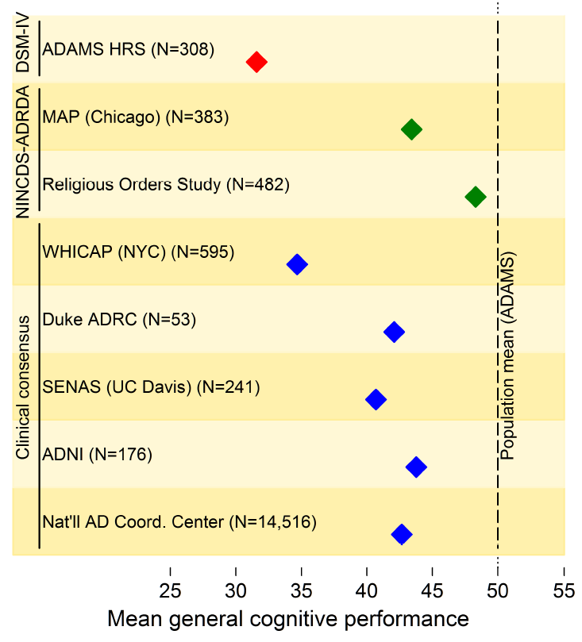
Example: Measuring Dementia
Gross and Jones (2012 GSA and submitted) identified cognitive measures used to predict incident dementia diagnoses in eight different cohort studies. They then used ADAMS cohort “cross-walk” data collected by Plassman and colleagues (funded by RC2 AG036554 ) to derive an underlying cognitive scale using IRT.

Slide 23
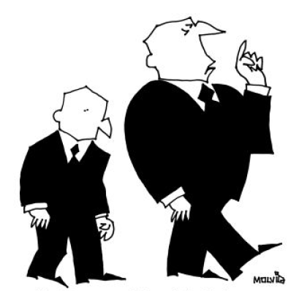
Ongoing Work with Financial Decision-making
“In this economy, it’s crucial to begin every
sentence with ‘in this economy.’”

Slide 24
(Financial) Decision-Making and Aging
Li, Johnson and Weber (2013) hypothesized and found evidence that the quality of decision-making at all ages depends on the balance between fluid and crystallized abilities, which vary with age.

Slide 25
Loss Aversion and Temporal Discounting Are Associated with Financial Knowledge
Li, Johnson, and Weber (2013)

Slide 26
…and Gain and Loss Learning are related to Assets and Debts
Knutson, Samanez-Larkin, and Kuhnen (2011) demonstrated that the amount of learning about gains and losses in a laboratory task is associated with Asset and Debt levels over and above the effect of age and “usual” cognitive variables.

Slide 27
Decision Effects that Do/Don’t Correlate with Cognitive Ability
Tasks that Do | Tasks that Do Not
Probability Matching | Anchoring Effects
Hindsight Bias | Sunk Cost Effects
Wason Card Selection Task | Risk/Benefit Confounding
Expected Value Maximization | Myside Bias
Overconfidence Effects | Certainty Effects
Causal Base Rate Usage | Non-causal Base Rate Usage
Summary from Stanovich and West (2008)

Slide 28
Transdermal Alcohol Detection
The Secure Continuous Remote Alcohol Monitor (SCRAM; a trademark of Alcohol Monitoring Systems) is a transdermal alcohol monitor than can be discreetly worn on the ankle, monitoring BAC 24/7 at 30 minute intervals.
The device uses a fuel cell to detect alcohol in the sweat that evaporates from the skin surface.
Photo: jezebel.com

Slide 29
Early Life Self-Regulation is a Predictor of Later Life Outcomes
The failure of Subject “O” to self-regulate optimally, alas, continued into adulthood…
…and so it came to pass that the adult Orpheus lost Eurydice, having failed not to look back.
Original by Antonio Canova

Slide 30
Deliberation vs. Rumination
Deliberation in some situations may facilitate decision-making, but optimal self-regulation does not consist of rumination (demonstrated here by Subject “H” and studied by Ian Gotlib).
In middle age, Hamlet continued to be indecisive and ruminated over actions he had or had not taken previously…
…including his decision about whether To Eat, or Not To Eat.
Original by William Morris Hunt (1864)

Slide 31
Effective self-regulation may include passionate and purposeful action
Subject “J” seizes the marshmallow, knowing early that bold action and “grit” (Duckworth, 2007) would be required…
…to reconquer France perhaps a dozen years later.
Original by D. C. G. Rossetti

Slide 32
Developing Attentional Assays and Verifying Target Engagement
Amygdala
Ian Gotlib is employing an Attentional Bias Training (ABT) technique to decrease attention to negative and increase attention to positive affective stimuli in the not depressed (but at risk) daughters of women with recurrent Major Depressive Disorder. Successful training (left) is associated with decreased reactivity in the amygdala (right) and increased activity in the prefrontal cortex (not shown) during an Emotional Interference Task.
Notes:
As it turns out, we have some preliminary evidence from one of the grantees funded by our Pasteur’s Quadrant FOA that this is indeed the case.
Ian Gotlib is now doing research on using an attentional training task to help shift attention away from negative stimuli, which is the default mode of attention in participants at high risk for depression. The goal is to get them to pay more attention to more emotionally positive information. And, as you can see in the left panel, this Attentional Bias Training (or ABT) was successful in this group of individuals, the daughters of women with recurrent major depression, who are at high risk both for depression and other maladaptive health behaviors. This attentional shift is associated with an increase in neural activity in prefrontal cortex (not shown here to keep the slide simpler), and a related decrease in activity in the amygdala, a brain structure strongly implicated in the processing of (especially negative) emotional stimuli.
In other words, ABT appears to have altered attentional set, as designed, and this change in attention has an effect on the processing of negative emotional stimuli in other relevant brain structures.
And this story raises the more general point about how we really need to study such targets and mechanisms of behavior change in the future. [next slide]

Slide 33
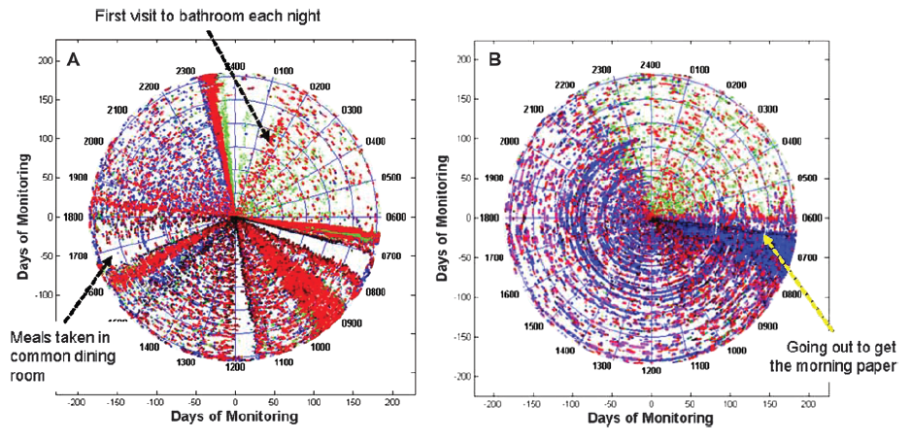
Activity Graphs from In-home Monitoring
“Spiral plots” of 24-hour monitoring; bathroom, entering bedroom, entering living room, and leaving the dwelling are color-coded. Left: resident in a continuing care community. Right: living alone, rarely leaves apartment. (Kaye et al., 2011)

Slide 34
BSR-supported studies are experimenting with accelerometers; the GENEA device shown is being used by the UK Biobank effort as well as the Whitehall study. (Photo: UK Biobank, 2011)

