Slide 1
Internal migration in china – impacts on children
Shuaizhang Feng
IESR, Jinan University

Slide 2
Migrant children
Left-behind children
The road ahead

Slide 3
Education of migrant children in China
Shuaizhang Feng
IESR, Jinan University

Slide 4
Background
Literature
Research questions
The Shanghai Migrant Student Survey
Main findings
This following materials are mainly based on joint research with Yuanyuan Chen from Shanghai University of Finance and Economics

Slide 5
Part 1: Background

Slide 6
Background: mass migration and the educational needs of migrant children
Mass rural-to-urban migration. (220 million) including over 20 million migrant children (without local Hukou)
Double disadvantages: institutional barriers (no local hukou thus legally excluded from public education) in addition to low Social Economic Status
Problems more serious in big cities such as Beijing, Shanghai and Guangzhou, due to large number of migrants and migrant children.
Limited public educational resources. Exacerbated by the spatial mismatch of migrant children and public schools
Notes:
Data based on 2010 Census. The number should be even larger now.

Slide 7
Background: migrant schools – low cost private schools
Started in the early 1990s as a market-based response to the educational demand of migrant children.
Enroll a substantial percentage of migrant students in cities (Shanghai 30%).
Usually privately-run, charge little tuition fees, easy to get into for migrant children, believed to be of lower quality than public schools, more likely to locate in peripheral regions of the city.
heterogeneities. Some are better than others in terms of “quality” of schools.
Not “in-the-system”. (体制内) In many places even illegal, subject to constant closures.
Notes:
For example, the education bureau would normally not administer the same tests to migrant schools as public schools. The teachers from migrant schools do not have bianzhi.

Slide 8
Background: migrant schools
Some Recent Developments
More attention and resources in recent years, from NGOs, local governments, volunteers, etc.
In Shanghai, from 2008-2010 “Three year action plan for the education of migrant children”
(1) All migrant students can enroll in public schools in the central districts.
(2) Remaining migrant schools in peripheral districts are “privatized” (民办转制). receive financial subsidies from local government and are subject to certain quality standard (annual checkup).
Notes:
“informal” or “illegal” schools turned into “private” schools.

Slide 9
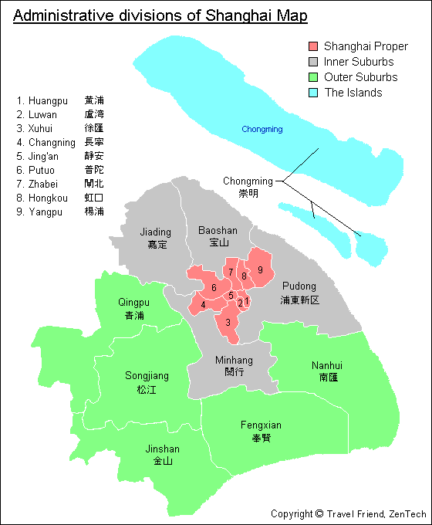
Map of Shanghai

Slide 10
Some background information about Shanghai
Based on the 2010 census, there are around 9 million migrants (39% of total resident population)
Around 0.5 million migrant students (non-local-HuKou) aged 6-14, which consists around 35% of Shanghai’s student population
Starting from 2008, all migrant schools in central districts are closed. Migrant students in those areas can enter public schools.
In peripherial districts, migrant schools are “privatized” (158) and migrant students can attend both type of schools.
Overall, 73.5% of migrant students are in public schools ; 26.5% in migrant schools (year 2011)

Slide 11
Per pupil funding support to migrant schools
Notes:
Consistent with research that funding or resources induces better educational outcomes.

Slide 12
Part II: Literature

Slide 13
existing literature
Most existing studies are case studies of one or two schools. Or very descriptive.
  Goodburn, 2009, Kwong, 2004; Han, 2004

Slide 14
existing literature (con’t)
Lai et al. (2011) mainly compares test scores of students from rural public school with urban migrant school. They also compared urban public schools with migrant schools but didn’t report detailed results as they only had 4 public schools.
Notes:
Need to find these two papers and take a more careful look.

Slide 15
Part III: Research questions
  What are the educational consequences if migrant students are in migrant schools as compared to public schools?
  How does the achievement score gap change over time, especially as migrant schools receive more resources?
  Are migrant students in public schools perform as well as their local hukou classmates?
  ….
Notes:
There are many other “smaller” questions

Slide 16
Part IV: The Shanghai Migrant Student Survey

Slide 17
Pilot survey: Nov 2008 (two migrant schools and two public schools)
The 2010 cohort
Round 1: Oct.-Nov. 2010 (4th grade) on site interviews and testing
Round 2: April-May 2012 (5th grade) on site interviews and testing
Two Telephone follow-up interviews of parents:
Oct.-Nov. 2012 (after sampled students graduated in July 2012)
Sept. – Oct. 2014 (Two years after they graduate)

Slide 18
The 2015 Cohort
New Cohort: Round 1, Nov 2015 (4th grade)
New Cohort: Round 2, May-June 2016

Slide 19
Round 1: Oct-Nov. 2010
20 schools, all 4th grader students
Unfortunately, it was not possible to randomly select schools.
But we try to find schools in different districts.
Public schools are those with certain % of migrant students.

Slide 20
Sample:
20 elementary schools, all 4th grade students

Slide 21
Questionnaire
School (completed by school principal)
  Student and teacher size，facilities，enrollment requirement etc.
Class (completed by class head teacher)
  Teacher qualifications, Student Behavior, class arrangement etc.
Student (partly by students; some info provided by teachers)
  Study behavior, habit etc. , health condition (height and weight)
Parent (taken back by students and completed by parents)
  Parent education, income, occupation, migration history, satisfaction, assessment of school quality
Standardized Test
  Chinese and Math (each 20 min), proctored by the head teacher and one interviewer.

Slide 22
Summary Statistics

Slide 23
Histogram of Standard Test Scores
Notes:
It is quite easy to eyeball the shifts in distribution.

Slide 24
Round 2: : April-May 2012
The same 20 schools, all 5th grader students now
CHANGE:
20 min math,10 min IQ (Raven’s), No Chinese

Slide 25
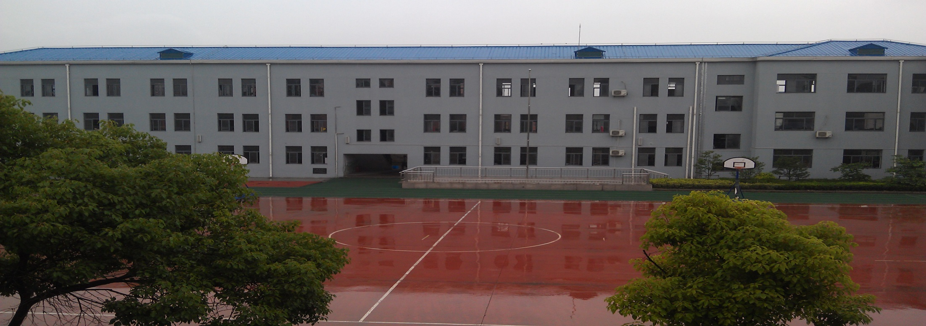
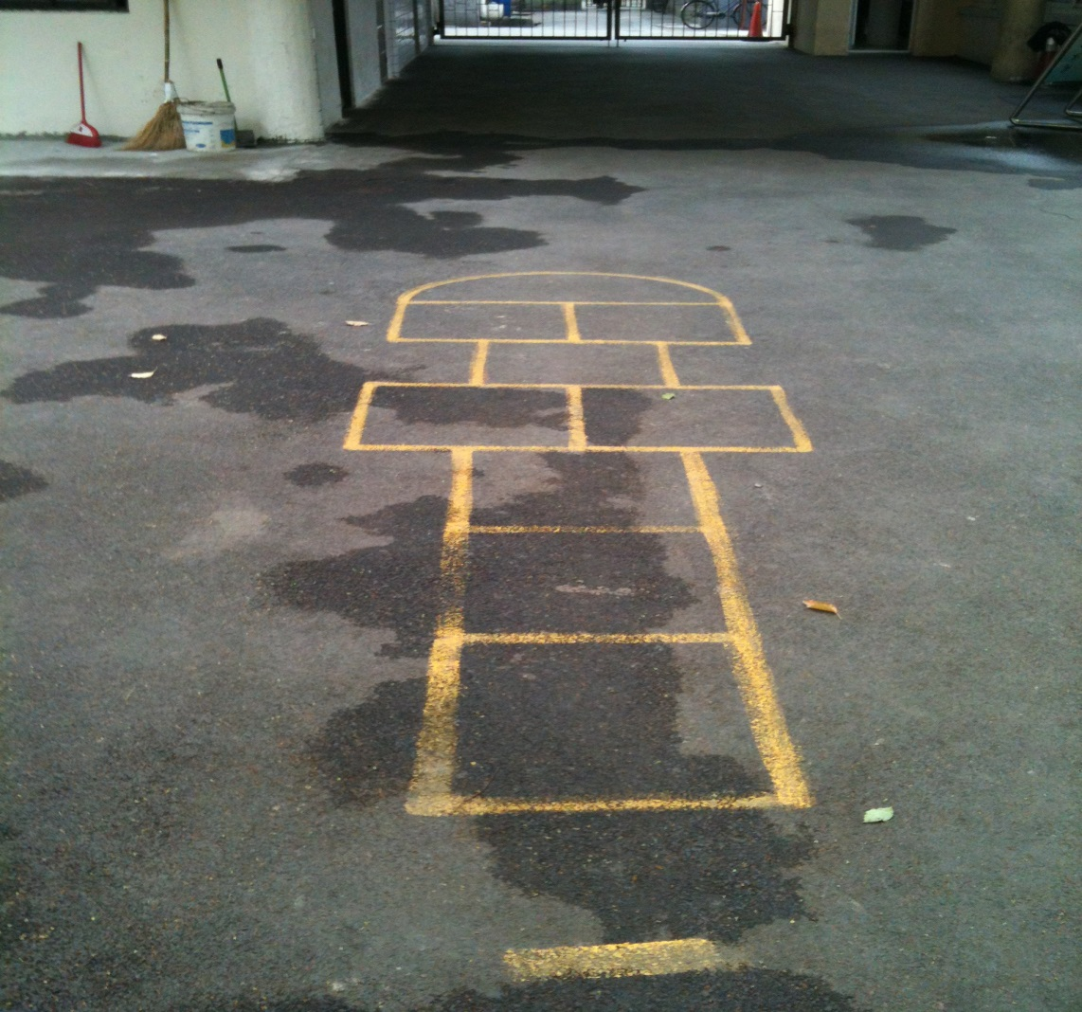
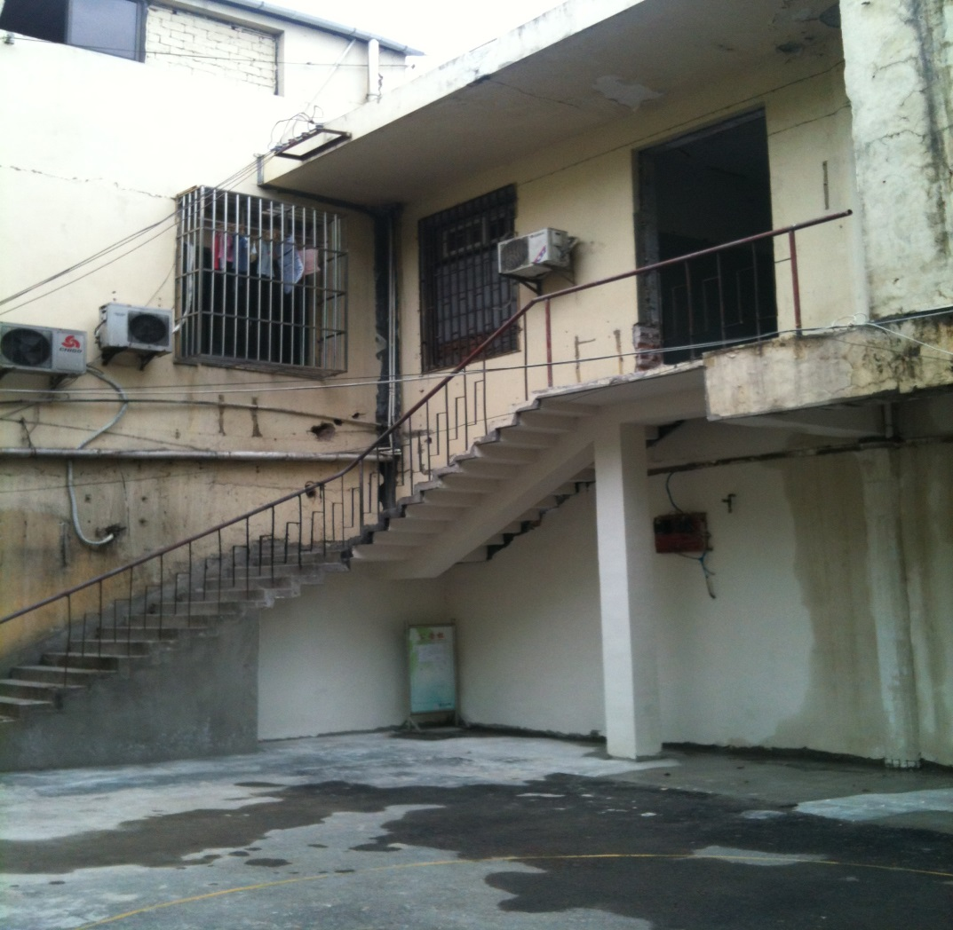
Notes:
Thanks to the smartphones, we can now take pictures of the schools and students more easily!

Slide 26
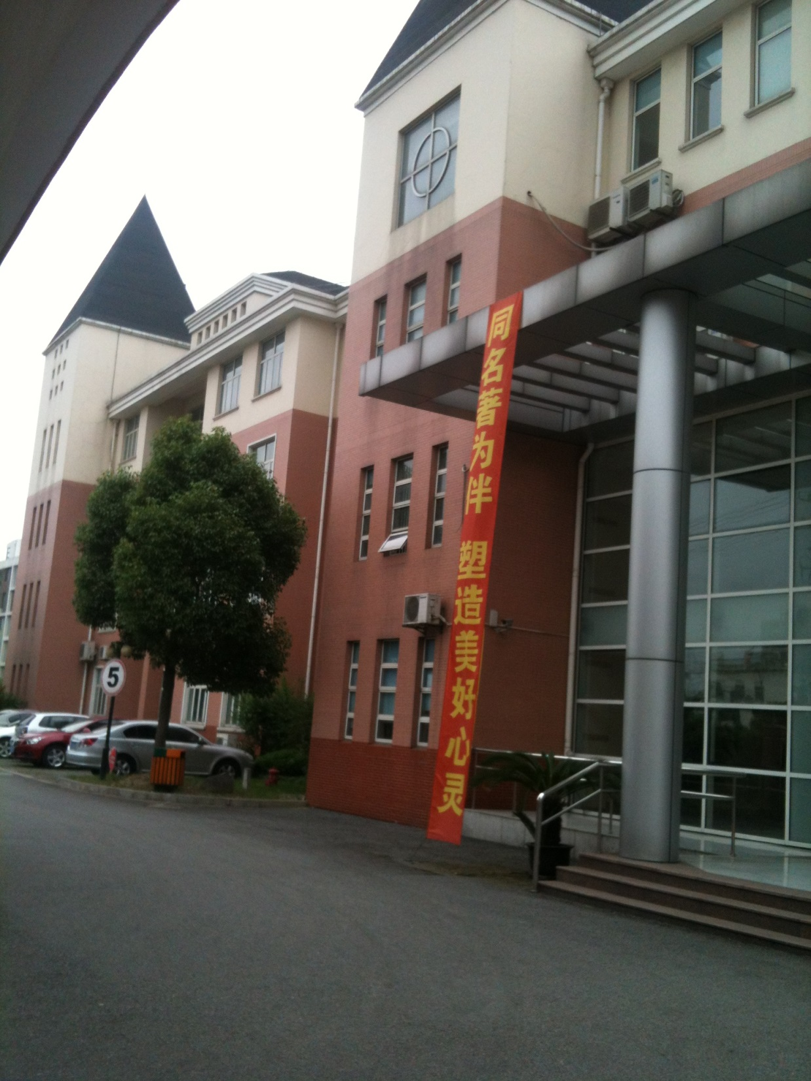
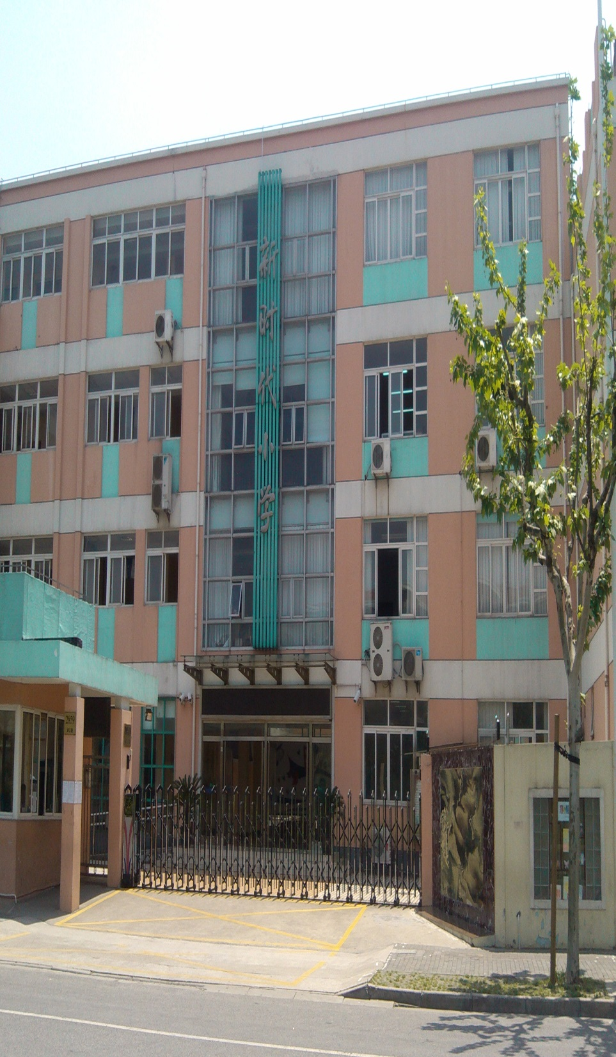

Slide 27
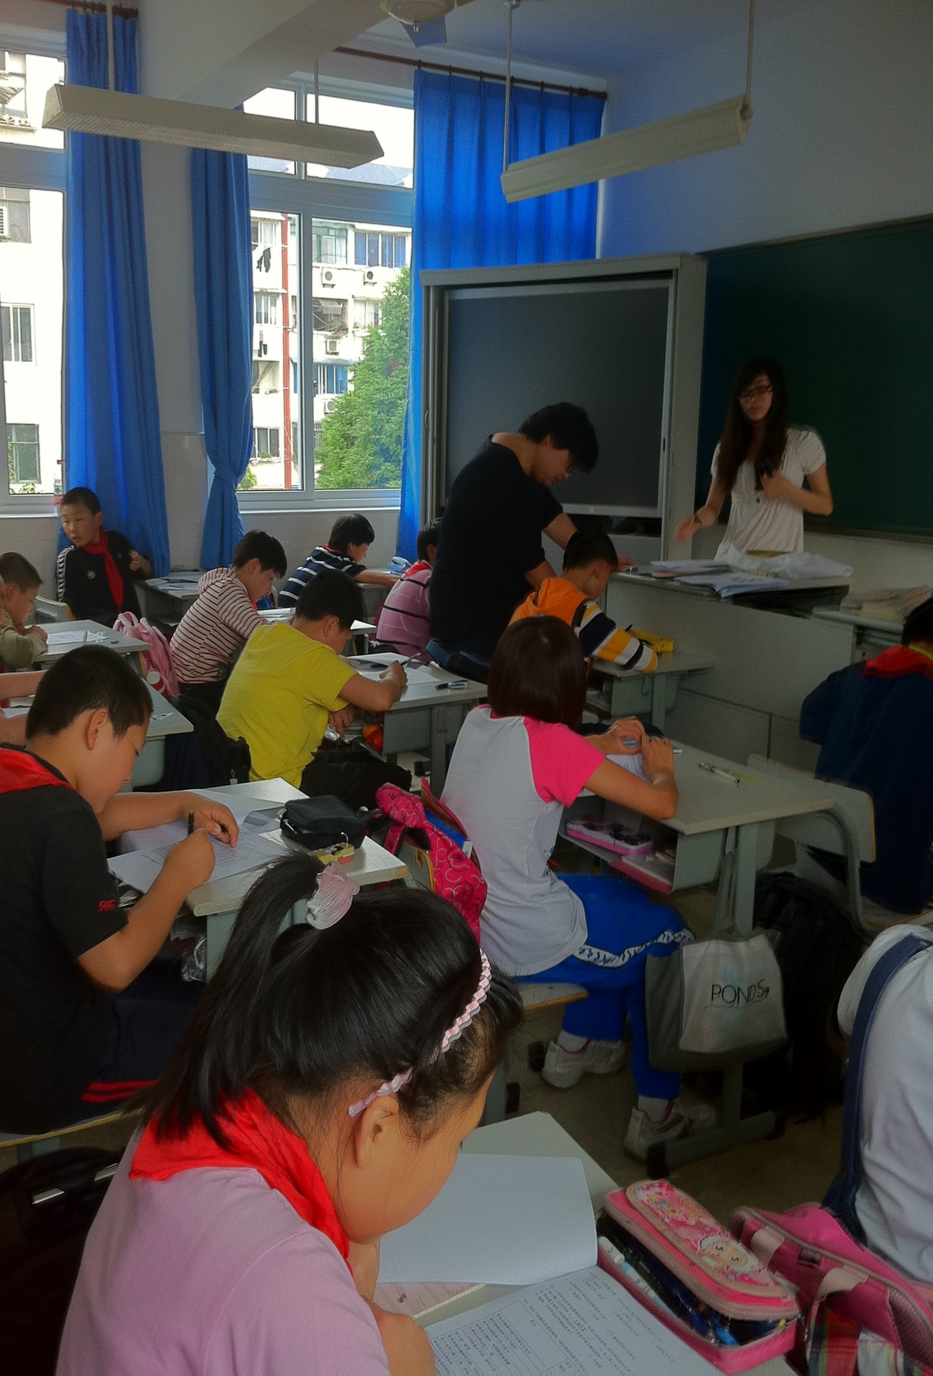
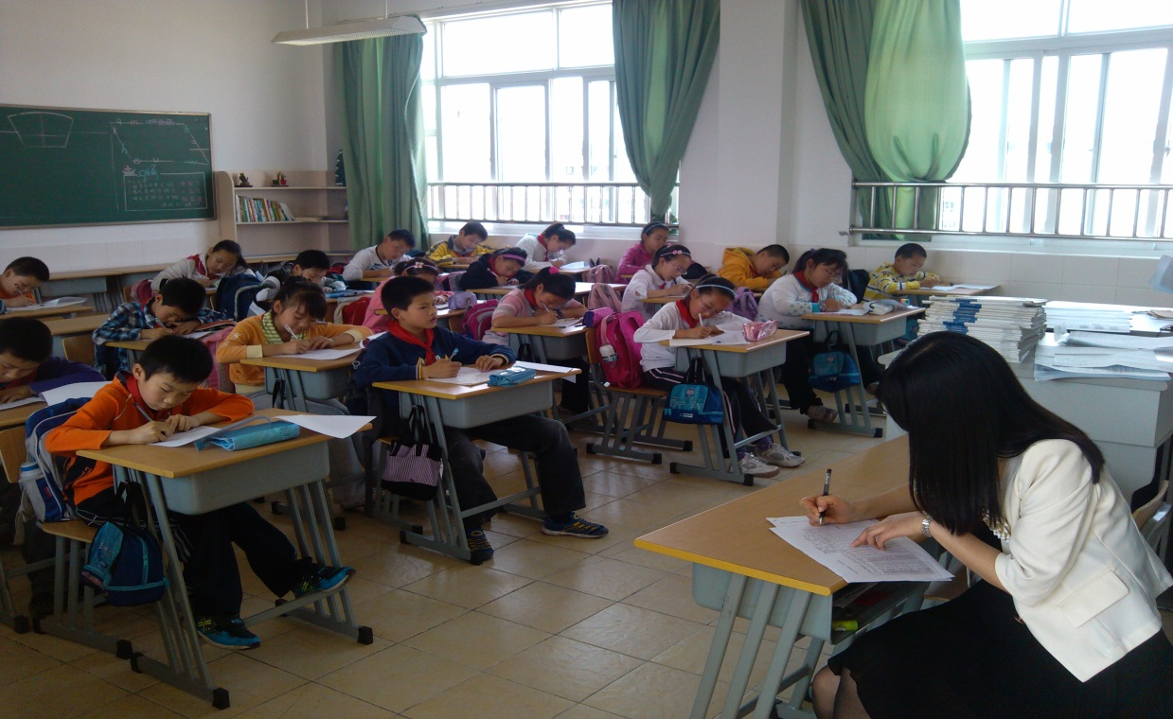
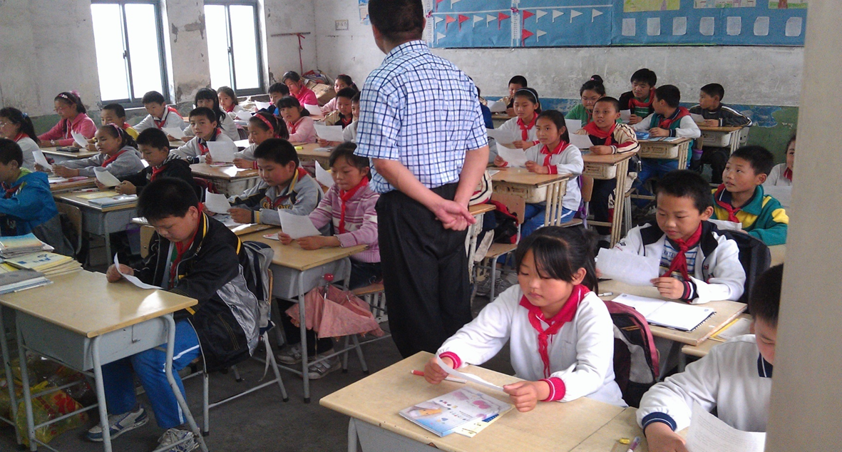

Slide 28
Sample: 20 elementary schools, all 4th grade students in round 1 and 5th grade in round 2
 | Migrant School | Public School
 | Round 1 (Fall 2010)
# of schools | 9 | 11
# of classes | 29 | 42
# of students | 1,343 | 1,280
- Shanghai |  | 673
- migrant | 1,343 | 607
 | Round 2 (Spring 2012)
# of schools | 9 | 11
# of classes | 29 | 42
# of students | 1,652 | 1,294
- Shanghai |  | 614
- migrant | 1,652 | 680
# of students in both years 1,046(78%) |  | 1,181(92%)
- Shanghai |  | 573
- migrant | 1,046 | 608

Slide 29
Telephone follow-up after graduation in 2012
Called all migrant parents in Oct. & Nov. 2012 and asked about (1) whether the migrant student is in Shanghai or not; (2) which school are they attending now (should be middle school in Shanghai); (3) when possible probed into reasons of going back to hometown or repeat a grade
Response rate is around 70%

Slide 30
Telephone follow-up in 2014
Called all migrant parents in Sept. & Oct. 2014 and asked about (1) current living place: Shanghai or hometown (2) which schools are they attending (3) current grade level
Response rate is around 60%

Slide 31
Part V: Main findings

Slide 32
Main findings: migrant students in migrant schools vs. migrant students in public schools, the first round of survey in 2010

Slide 33
Empirical methodology
1. Basic Regression:
    Yi: - standardized test score (OLS)
      parental overall satisfaction (ordered probit)
      parental assessment of school quality (ordered probit)
    Mi: migrant schools
    Xi: student and family characteristics
  2. IV estimation
    Z (IV) :Whether live in central district before the kid starts school (2007)
      The key identifying assumption is that choice of residence is NOT related to unobserved factors that determines test score in 2010.
      If parents know the policy in change in 2008 and chose to live in central districts in 2007 then this assumption would be violated.

Slide 34
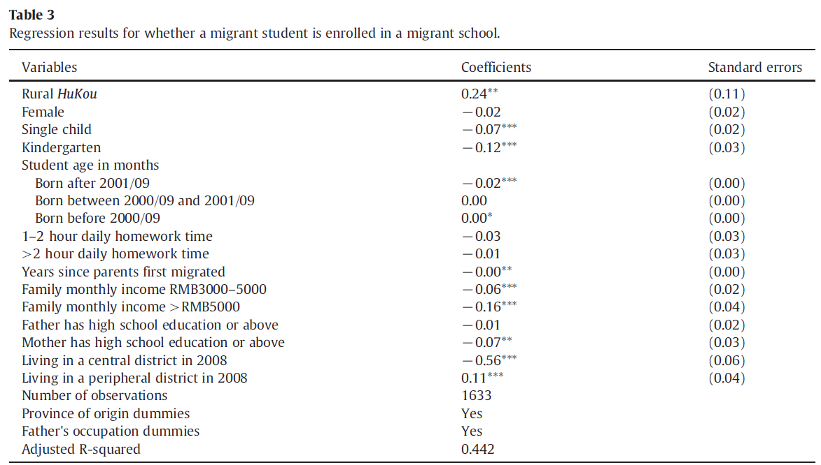
First Stage Regression

Slide 35
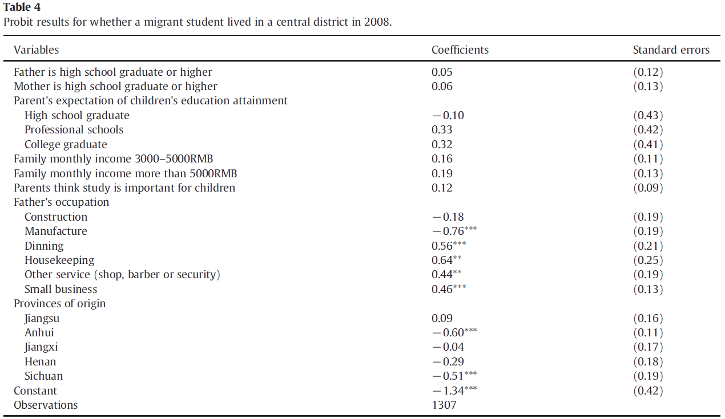

Slide 36
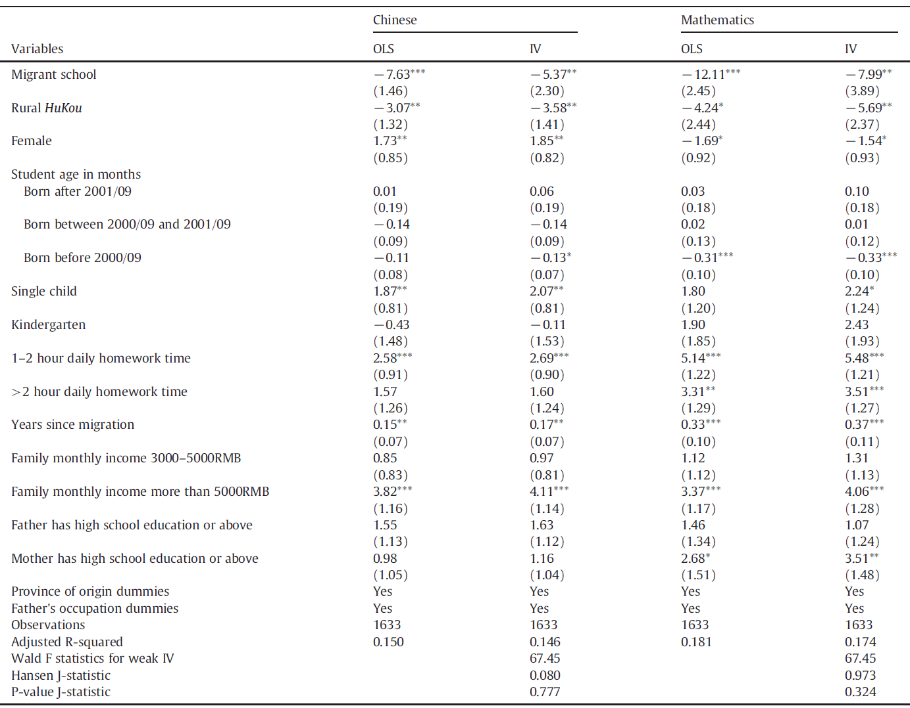
Basic Result

Slide 37
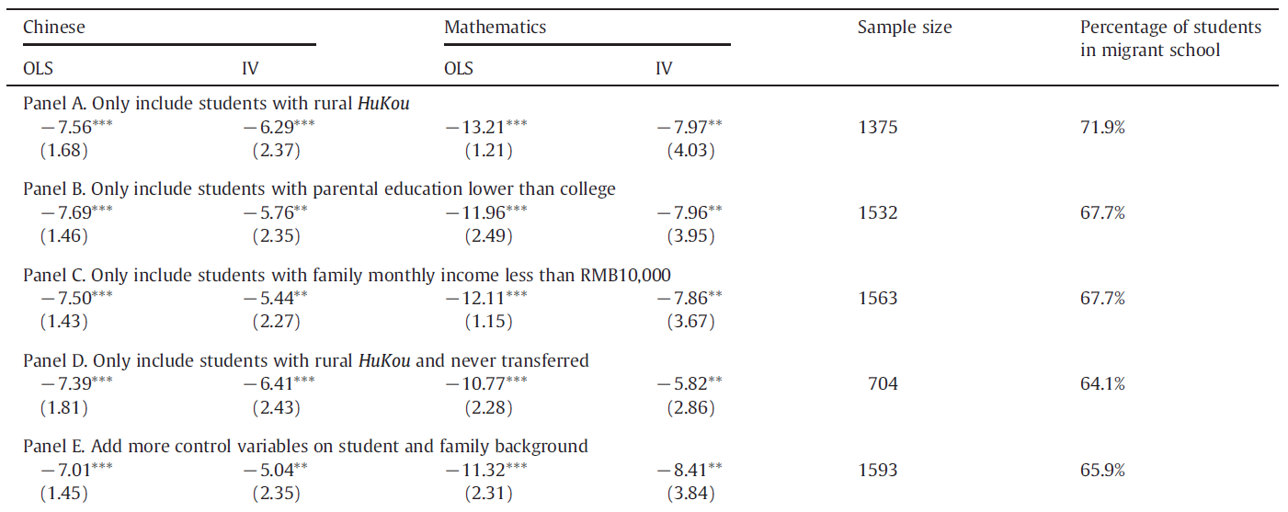
Robustness Check

Slide 38
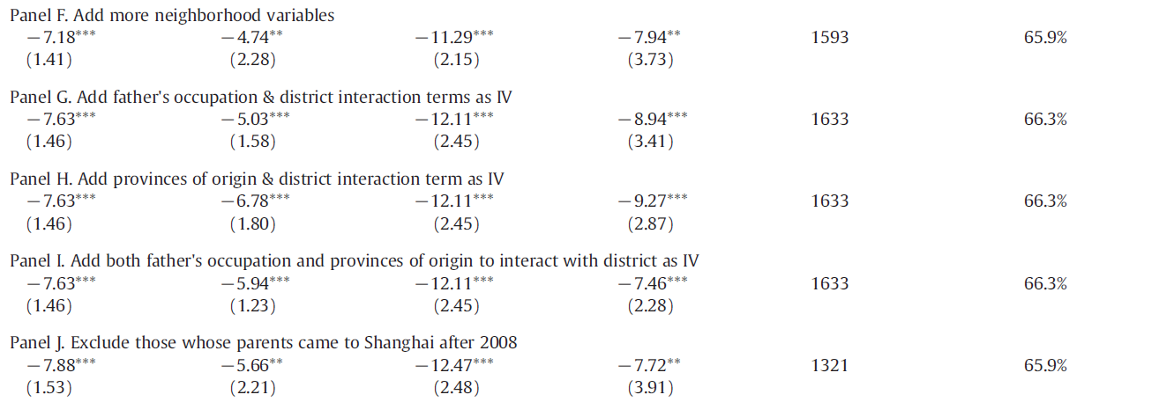
Robustness Check

Slide 39
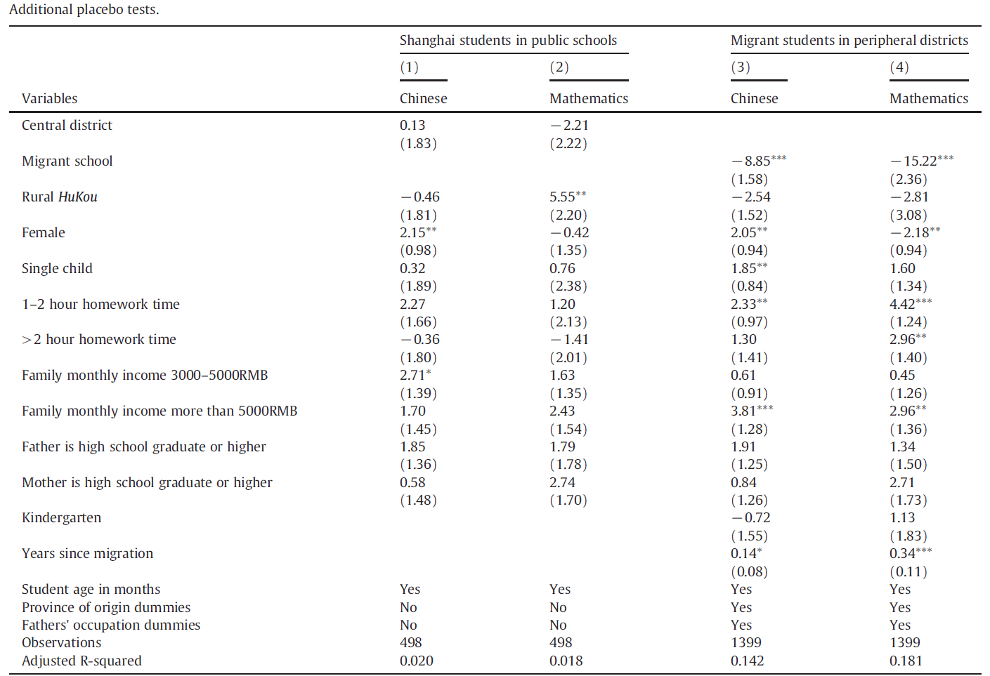
Is it just a center-periphiral difference

Slide 40
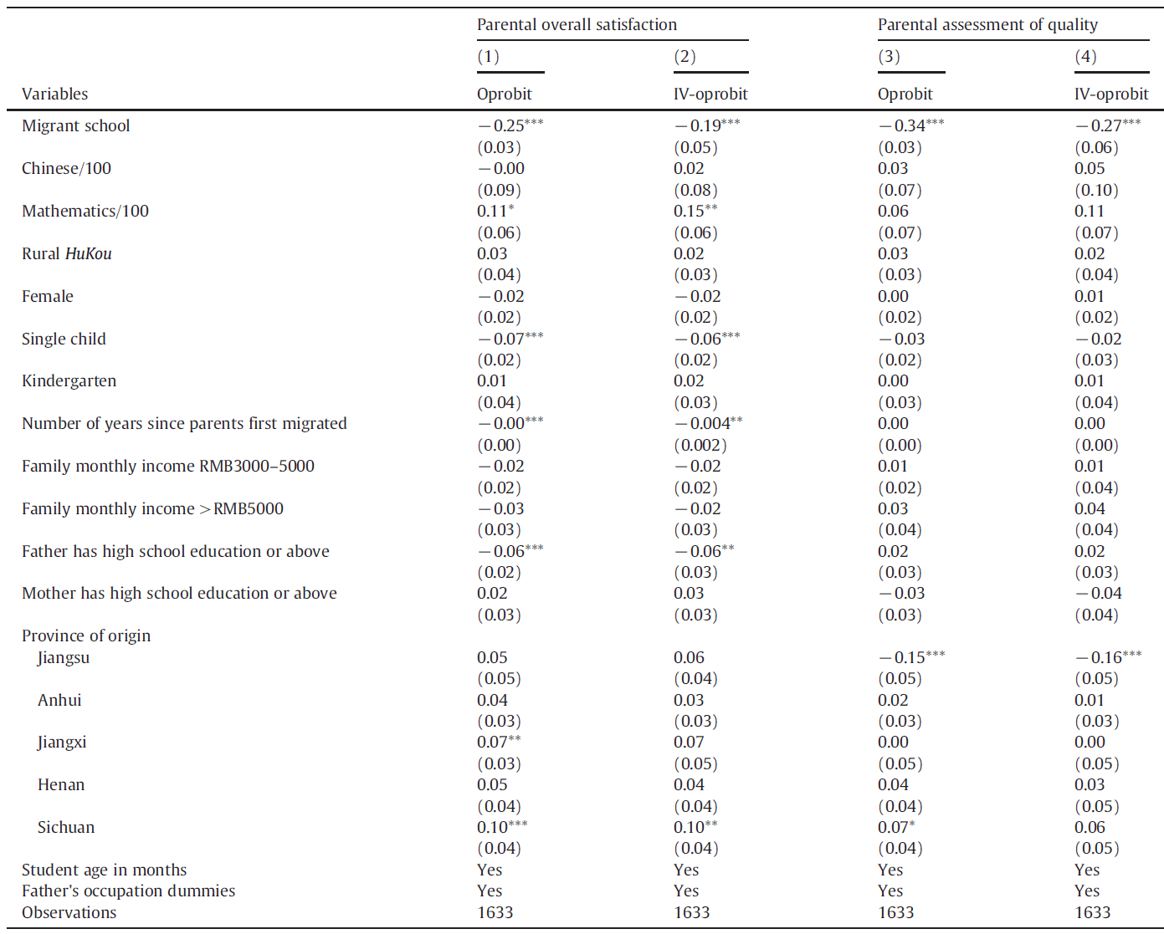
Notes:
Parents in migrant schools are not satisfied compared to public schools. And they have lower rating of migrant schools.

Slide 41
Difference of School Characteristics:

Slide 42
Main findings: migrant students in migrant schools vs. migrant students in public schools, the second round of survey in 2012 and the follow-up phone interviews

Slide 43
Methodology: Diff-in-Diff type of regression
Y is the outcome variable (test score)
M is dummy for migrant school (M=0 mig school; M=1 public school)
T is year (t=0 if 2010; t=1 if 2012)
X is a control vector
Errors clustered at class level
Note we can also use fixed effects

Slide 44
Some notes on methodology
We are following the same students in the same schools in the two periods
Interaction terms captures the differential change for migrant children in migrant schools and public schools. Treatment is defined (implicitly) as what happened in mig schools beyond those in public schools
Self-selection into different type of schools. Not so much to worry as in a cross sectional study
Notes:
(1) As long as the underlying trend without treatment is the same for both groups, this should be fine. (2) we will be able to provide some check on whether this assumption makes sense later. (3) controlling or not controlling for IQ provides upper and lower bounds.

Slide 45
Summary statistics: by type of students
 | Public schools |  | Migrant schools
 | Shanghai students | Migrant students
Age (Round 2) | 11.4 | 11.6 | 11.6
female | 0.5 | 0.4 | 0.4
rural hukou | 0.1 | 0.7 | 0.9
single child | 1.0 | 0.4 | 0.3
kindergarten | 1.0 | 1.0 | 0.9
father high sch | 0.80 | 0.45 | 0.27
mother high sch | 0.76 | 0.29 | 0.18
family Income (Round 2)
-Below RMB3000 | 0.21 | 0.16 | 0.31
-RMB3000-5000 | 0.31 | 0.37 | 0.45
-Above RMB5000 | 0.48 | 0.47 | 0.24

Slide 46
 | Public schools |  | Migrant schools
 | Shanghai students | Migrant students
Province of origin
-Shanghai | 1.00 | 0.00 | 0.00
-Jiangsu | 0.00 | 0.14 | 0.06
-Anhui | 0.00 | 0.28 | 0.49
-Jiangxi | 0.00 | 0.08 | 0.06
-Henan | 0.00 | 0.08 | 0.10
-Sichuan | 0.00 | 0.07 | 0.10
-Other | 0.00 | 0.35 | 0.19
Parental Occupation (Round 2)
- construction |  | 0.09 | 0.11
- manufacturing |  | 0.10 | 0.30
-service |  | 0.19 | 0.15
- small business |  | 0.46 | 0.29
- other |  | 0.15 | 0.15

Slide 47
 | Public schools |  | Migrant schools
 | Shanghai students | Migrant students
Math score
- round 1 | 64.4 | 63.0 | 47.5
- round 2 | 59.8 | 56.2 | 45.4
Normalized math score
- round 1 | 0.50 | 0.43 | -0.32
- round 2 | 0.48 | 0.29 | -0.27
IQ (round 2) | 11.49 | 11.61 | 10.47
Parental satis (Round 1)
-not satisfied | 5.7% | 2.6% | 10.1%
-Satisfied | 68.5% | 53.3% | 67.0%
-very satisfied | 25.8% | 44.1% | 23.0%
Parental satis (Round 2)
-not satisfied | 5.7% | 2.0% | 8.6%
-Satisfied | 69.9% | 50.7% | 63.8%
-very satisfied | 24.4% | 47.4% | 27.7%

Slide 48
 | Public schools |  | Migrant schools
 | Shanghai students | Migrant students
Parenal eval sch (Round 1)
- worse |  | 4.6% | 11.9%
- similar |  | 15.2% | 40.9%
- better |  | 80.1% | 47.2%
Parenal eval sch (Round 2)
- worse |  | 4.9% | 10.1%
- similar |  | 16.5% | 35.5%
- better |  | 78.6% | 54.5%
Attri. Between rounds (%) | 1.7% | 7.2% | 18.4%
Post-graduation
- school in Shanghai |  | 71.6% | 53.5%
- school in hometown |  | 6.0% | 25.2%
- others |  | 0.0% | 0.3%
- Don't Know |  | 22.5% | 21.1%

Slide 49
Test score gap (norm. math)
 | (1) | (2) | (3) | (4) | (5)
Migrant school*round2 | 0.19** | 0.25*** | 0.27*** | 0.25** | 0.24***
 | (0.09) | (0.09) | (0.09) | (0.10) | (0.06)
Migrant school | -0.75*** | -0.68*** | -0.62*** | -0.50***
 | (0.12) | (0.12) | (0.12) | (0.11)
Round2 | -0.14** | -0.17 | -0.42 | -0.18
 | (0.06) | (0.43) | (0.45) | (0.48)
IQ |  |  |  | 0.14***
 |  |  |  | (0.01)
Observations | 2,478 | 2,478 | 2,478 | 2,478 | 1,239
Adjusted R-squared | 0.109 | 0.143 | 0.166 | 0.266 | 0.026
No other controls
Controlling for student characteristics
Also controlling for parental and family characteristics
Also controlling for IQ
Fixed effects
Notes:
Other controls also included. # of hours spent on homework; family income; father’s education; mother’s education; year since parents migrated; province of origin; father’s occupation. All X interacted with t.

Slide 50
Robustness checks
 | (1) | (2) |  | (3) | (4) |  | (5)
 | NOT Control IQ |  |  | Control IQ |  |  | # of students
 | Mig Sch | Mig Sch *R2 |  | Mig Sch | Mig Sch*R2 |  | % in mig school
A. Include only Rural Hukou students
 | -0.66*** | 0.30*** |  | -0.54*** | 0.27** |  | 2,087
 | (0.13) | (0.10) |  | (0.12) | (0.10) |  | 69.1%
B. Exclude those whose parents own an apartment in Shanghai.
 | -0.60*** | 0.30*** |  | -0.47*** | 0.27*** |  | 2,240
 | (0.12) | (0.09) |  | (0.11) | (0.09) |  | 66.2%
C.Only include students with family monthly income less than RMB10,000
 | -0.61*** | 0.26*** |  | -0.49*** | 0.24** |  | 2,315
 | (0.12) | (0.09) |  | (0.11) | (0.09) |  | 65.3%
D. Only include students with parental education lower than college
 | -0.61*** | 0.26*** |  | -0.50*** | 0.25** |  | 2,335
 | (0.12) | (0.10) |  | (0.11) | (0.10) |  | 64.8%
E. Include both Shanghai Student and Migrant Students
 | -0.66*** | 0.30*** |  | -0.53*** | 0.29*** |  | 3,964
 | (0.12) | (0.09) |  | (0.11) | (0.09) |  | 49.4%
F. Adjust for attrition
 | -0.62*** | 0.29*** |  | -0.50*** | 0.27** |  | 2,459
 | (0.12) | (0.10) |  | (0.11) | (0.10) |  | 63.00%
Notes:
A-D try to make the sample closer to the “migrant farmer’s children” type of definition. E use different controls groups. F adjust for sample attrition during the two periods.

Slide 51
Test score gaps, quantile results
 | Q10 | Q25 | Q50 | Q75 | Q90
Migrant school*R2 | 0.45*** | 0.34*** | 0.34*** | 0.07 | -0.10
 | (0.12) | (0.09) | (0.11) | (0.12) | (0.13)
Mig sch | -0.57*** | -0.57*** | -0.48*** | -0.43*** | -0.37***
 | (0.09) | (0.06) | (0.08) | (0.08) | (0.09)
R2 | 0.09 | 0.43 | -0.64 | -0.63 | 1.87**
 | (0.86) | (0.65) | (0.77) | (0.77) | (0.87)
IQ | 0.15*** | 0.16*** | 0.15*** | 0.12*** | 0.13***
 | (0.01) | (0.01) | (0.01) | (0.01) | (0.02)
Rural Hukou | -0.20** | -0.20*** | -0.08 | -0.03 | 0.04
 | (0.09) | (0.07) | (0.09) | (0.10) | (0.10)
Female | -0.04 | -0.02 | -0.04 | -0.14** | -0.06
 | (0.08) | (0.06) | (0.07) | (0.07) | (0.08)
Age in month | -0.01*** | -0.00 | -0.00 | -0.00 | 0.00
 | (0.00) | (0.00) | (0.00) | (0.00) | (0.00)
Single Child | 0.03 | 0.09 | 0.12 | -0.01 | 0.09
 | (0.08) | (0.06) | (0.07) | (0.08) | (0.09)
Kindergarten | 0.19 | -0.09 | -0.13 | -0.05 | 0.19
 | (0.13) | (0.09) | (0.11) | (0.12) | (0.13)
Notes:
lower end of distri. converged more. Consistent with the story that an improvement in student quality of mig schools would benefit low-performing student more

Slide 52
Parental evaluation of school quality
How do you compare the quality of schooling that your child have now to what he/she would have if study in your hometown?
1)Quality of education is better now 2) similar 3) quality of education is better in hometown
您觉得目前孩子在上海读书和他（她）如果继续在老家读书相比如何？
1) 目前的教学质量好 2) 差不多 3) 老家的教学质量好

Slide 53
Parental-assessed quality also improved
 | (1) | (2) | (3) | (4)
Migrant school*R2 | 0.08** | 0.09** | 0.11*** | 0.11***
 | (0.04) | (0.04) | (0.04) | (0.04)
Migrant school | -0.30*** | -0.30*** | -0.32*** | -0.31***
 | (0.03) | (0.03) | (0.03) | (0.03)
R2 | -0.02 | -0.32 | -0.38 | -0.36
 | (0.03) | (0.23) | (0.24) | (0.23)
Stand Math |  |  |  | 0.02
 |  |  |  | (0.01)
Stand Math*R2 |  |  |  | 0.01
 |  |  |  | (0.02)
No other controls
Controlling for student characteristics (including IQ)
Also controlling for parental and family characteristics
Also controlling for math score

Slide 54
Possible alternative stories:
Does students/parents in migrant schools work harder or care more about education now?
We examine the following.
(1) 做作业和温习功课？ 1）不会 2）<1小时； 3） 1－2小时； 4）>2小时
(2) 你父母经常辅导你做作业吗？ 1）经常(至少每周两次)； 2）偶尔（每周一次或不到）； 3）从不
(3) 我遇到问题就向老师求助 1)经常(至少每周两次) 2)偶尔（每周一次或不到） 3)从不

Slide 55
(4) 您觉得孩子现在的学习对他／她的未来影响大吗？ 1）非常大； 2）有一些影响； 3）基本没有影响；
(5)您或小孩的其他家长平均每天辅导孩子学习的时间大约是 小时；
(6) 您希望孩子未来的教育程度至少能达到：1）初中； 2）高中或中专； 3）大专； 4）大学本科及以上；
(7) 家长是否关心其学习? 1.非常关心； 2.有时关心； 3.不关心；(from student info sheet provided by head teacher)

Slide 56
 |  | Migrant School*Round2
 |  | coefficient | s.e
1 | Time Spent on Homework (student report) | -0.07* | (0.04)
2 | How often do you ask your teacher to help you | 0.07 | (0.04)
3 | How often do your Parent tutor your homework | 0.05 | (0.04)
4 | Weekly Hours parent spend on tutoring student homework | 0.01 | (0.04)
5 | Whether parent think study is important | 0.06 | (0.06)
6 | Parent Expectation of children ultimate education level | 0.02 | (0.03)
7 | Whether parents care children's study (evaluated by the head teacher) | 0.03 | (0.06)

Slide 57
Parental overall satisfaction
Overall, are you satisfied with the school that your child is currently attending? 1) very satisfied 2) satisfied 3) not satisfied
综合而言，您对目前孩子就学的学校满意程度如何？ 1）非常满意 2）基本满意 3）不满意

Slide 58
Parental overall satisfaction have not improved
 | (1) | (2) | (3) | (4)
Migrant school*R2 | 0.02 | 0.02 | 0.03 | 0.03
 | (0.04) | (0.04) | (0.04) | (0.05)
Migrant school | -0.21*** | -0.22*** | -0.24*** | -0.22***
 | (0.03) | (0.03) | (0.03) | (0.03)
R2 | 0.03 | 0.24 | 0.26 | 0.27
 | (0.02) | (0.22) | (0.25) | (0.25)
Stand Math |  |  |  | 0.03**
 |  |  |  | (0.02)
Stand Math*round2 |  |  |  | 0.01
 |  |  |  | (0.02)
No other controls
Controlling for student characteristics (including IQ)
Also controlling for parental and family characteristics
Also controlling for math score

Slide 59
Whether stay in SH after graduation
 | (1) | (2) | (3) | (4) | (5) | (6)
Marginal effect of probit | ALL | ALL | ALL | Exclude those who prefer to go to migrant schools | Exclude those who plan to leave Shanghai within 5 years | Exclude those who came to Shanghai for less than five years
Migrant school | -0.22*** | -0.23*** | -0.22*** | -0.20*** | -0.18*** | -0.22***
 | (0.03) | (0.03) | (0.03) | (0.03) | (0.04) | (0.03)
Standarized Math Score |  | -0.01 | 0.01 | 0.01 | -0.01 | 0.01
 |  | (0.01) | (0.02) | (0.02) | (0.02) | (0.02)
Migrant*Math Score |  |  | -0.02 | -0.01 | -0.00 | -0.02
 |  |  | (0.03) | (0.02) | (0.03) | (0.03)
Notes:
Other controls also included. Here we do need to worry about selection. Thus we have some robustness check results. The idea of last three columns is to rule out those in migrant schools who wanted to leave shanghai after graduation.

Slide 60
Grade distribution in Oct. 2014
 | Shanghai students | migrant students in public school | migrant students in migrant school
 |  |  | back home | stay in Shanghai
7th grade | 5 | 1 | 53 | 16
8th grade | 293 | 302 | 429 | 261
Notes:
Much more grade retention for students from migrant schools.

Slide 61
Migrant students from migrant schools are more likely to repeat a grade (reg results)
 | All migrant children | migrant children who stay in Shanghai | migrant children back home
migrant school | -0.06*** | -0.05** | -0.06***
 | (0.01) | (0.02) | (0.02)
standardized Math | 0.03*** | 0.01** | 0.05***
 | (0.01) | (0.01) | (0.01)

Slide 62
Discussions: a more detailed look at the policy changes
What has changed?
What has not changed?
What should be done in the future?

Slide 63
Some evidence that teachers are getting better in mig schools
 |  | 2010 |  |  | 2012
 |  | Migrant School | Public |  | Migrant School | Public
Class size |  | 47.5 | 31.5 |  | 50.0 | 31.1
student teacher ratio |  | 22.3 | 11.4 |  | 23.6 | 11.7
Teaching experience (years)
 | - Less than 3 years | 0.23 | 0.04 |  | 0.13 | 0.04
 | - 3 to 5 years | 0.38 | 0.06 |  | 0.34 | 0.06
 | - More than 6 years | 0.39 | 0.90 |  | 0.54 | 0.90
Teacher's Tenure (years)
 | - Less than 3 years | 0.66 | 0.07 |  | 0.18 | 0.05
 | - 3 to 5 years | 0.27 | 0.10 |  | 0.69 | 0.12
 | - More than 6 years | 0.06 | 0.83 |  | 0.13 | 0.83
Teachers' education
 | - High school and below | 0.24 | 0.05 |  | 0.21 | 0.02
 | - Associate degree | 0.59 | 0.36 |  | 0.60 | 0.32
 | - BA degree and above | 0.16 | 0.58 |  | 0.19 | 0.66
Monthly salary
 | - Below RMB3000 | 0.80 | 0.01 |  | 0.41 | 0.00
 | - RMB3000 to RMB4000 | 0.18 | 0.03 |  | 0.35 | 0.03
 | - RMB4000 to RMB5000 | 0.02 | 0.26 |  | 0.23 | 0.11
 | - Above RMB5000 | 0.00 | 0.71 |  | 0.01 | 0.87

Slide 64
Institutional barriers remain intact
(more so for migrant school students)
Migrant middle schools not allowed in Shanghai.
Spaces in public middle schools limited (not expanding). In 2011, 130,857 elementary school students graduated, while middle schools admitted 116,200 students. Corresponding stats in 2010 are (124,353 & 120,600).
This somehow reflect more fundamental institutional problems
No change in College Entrance Exam policy. (You only take CEE at your hukou place)
No change in HuKou policy (points-system unlikely to benefit migrant parents we talk about here very soon).

Slide 65
Main results:
Based on test scores, migrant children attending migrant schools perform worse than their counterparts in public schools. But the gap has been substantially reduced due to increased funding and possibly other changes.
Parental subjective evaluation of school quality also converged.
But
Differences in terms of parental satisfaction did not converge as test score gaps.
This might be related to possible upside opportunities for migrant children. The probability of entering middle schools in Shanghai after graduation is significantly less for those in migrant schools, even after controlling for test scores.

Slide 66
Summary
Quality of migrant schools have improved considerably, along with increasing financial support from the Shanghai government.
Parents remain unsatisfied and students from migrant schools are less likely to stay in Shanghai and become “left-behind” children.
Policy implication. Financial support from the government works and other cities could learn from Shanghai’s experience. However, without major institutional reforms, efforts just focusing on improving the “quality” of migrant schools are unlikely to be sufficient.
Long run consequences of attending migrant schools could be much more serious than just learning in school due to institutional barriers.

Slide 67
Main findings: migrant students in public schools vs. local students in public schools

Slide 68
Same sample but we now focus on public schools only

Slide 69
Key questions to ask
1. Conditional on entering public schools, are migrant students more likely to enter better or worse schools?
2. How do migrant students perform compared to their local classmates (schoolmates)?
3. Is there a negative externality imposed by migrant students (peer effect)?

Slide 70
Summary statistics
 |  | Shanghai students | Migrant students
Panel A: Test scores
Raw Math (Wave 1) |  | 65.51 | 63.03
Raw Math (Wave 2) |  | 61.05 | 56.19
Standardized Math (Wave 1) |  | 0.55 | 0.43
Standardized Math (Wave 2) |  | 0.54 | 0.29
IQ (Wave 2) |  | 11.60 | 11.61
Panel B: Other Outcomes
Groupleader |  | 0.38 | 0.38
Teacher's Evaluation
 | Worst | 2.3% | 1.2%
 | relatively bad | 9.0% | 8.2%
 | average | 26.6% | 28.6%
 | relatively good | 29.6% | 36.9%
 | very good | 32.4% | 25.1%

Slide 71
Summary stat: student characteristics
 |  | Shanghai students |  | Migrant students
Panel C: Student Characteristics
Age (Wave 2) |  |  | 11.4 | 11.6
Female |  |  | 0.50 | 0.45
Rural HuKou |  |  | 0.06 | 0.71
Single Child |  |  | 1.00 | 0.45
Kindergarten |  |  | 1.00 | 0.96

Slide 72
Summary stat: family background
 |  | Shanghai students | Migrant students
Panel D:Family Background
Father High School & Above |  | 0.81 | 0.45
Father College & Above |  | 0.12 | 0.03
Mother High School & Above |  | 0.78 | 0.29
Mother College & Above |  | 0.10 | 0.01
Family Income (Wave 2)
 | -Below RMB3K | 0.18 | 0.16
 | -RMB3-5K | 0.31 | 0.37
 | -Above RMB5K | 0.52 | 0.47
Teacher's Evaluation of Parents careness of children
 | Very Care | 43.1% | 29.0%
 | Occationally Care | 43.5% | 50.6%
 | Not Care | 13.4% | 20.4%
Reason for living at current place
 | work | 8.8% | 45.1%
 | children's education | 12.2% | 36.5%
 | family reason | 38.7% | 8.8%
 | others | 40.3% | 9.6%
Home Ownership |  | 0.89 | 0.19
Enter school with effort |  | 0.44 | 0.74

Slide 73
How do we measure school quality
We use two different measures
Measure #1: we construct an index of school quality based on observed characteristics of schools
Measure #2: use migrant parents’ subjective evaluation of schools

Slide 74
“Objective” measure of school quality
1.School history
2. total enrollment
3. teacher/student ratio
4. education of teachers
5. tenure of teachers
6. teacher’s qualifications (certificate)
7. turnover of teachers
8. salary level of teachers
9. parental evaluation

Slide 75
The two measures are highly correlated

Slide 76
 | (1) | (2) | (3) | (4) |  | (5) | (6) | (7) | (8)
 | School Overall Quality Index |  |  |  |  | Parent Evaluated Quality
 | All | All | Migrant | Local |  | All | All | Migrant | Local
Shanghai hukou | 0.97*** | -0.80 |  |  |  | 1.13* | -1.56
 | (0.33) | (0.57) |  |  |  | (0.62) | (1.05)
Rural hukou |  | -0.68 | -1.47** |  |  |  | -1.28 | -2.75**
 |  | (0.45) | (0.58) |  |  |  | (0.84) | (1.07)
Own house |  | 0.75 | 0.43 | 0.93 |  |  | 0.84 | 0.48 | 0.44
 |  | (0.52) | (0.73) | (0.73) |  |  | (0.97) | (1.35) | (1.35)
Female |  | -0.23 | -0.31 | -0.26 |  |  | -0.38 | -0.42 | -0.58
 |  | (0.33) | (0.52) | (0.39) |  |  | (0.62) | (0.96) | (0.73)
Age in month |  | -0.03 | -0.03 | -0.01 |  |  | -0.12** | -0.14** | -0.01
 |  | (0.03) | (0.03) | (0.05) |  |  | (0.05) | (0.06) | (0.09)
Single child |  | 0.71 | 0.59 | -1.67 |  |  | 1.16 | 0.92 | -4.81
 |  | (0.46) | (0.53) | (2.93) |  |  | (0.85) | (0.99) | (5.44)
Family income 3000-5000 |  | 0.46 | 1.39* | -0.61 |  |  | 1.39 | 3.63*** | -1.12
 |  | (0.49) | (0.75) | (0.59) |  |  | (0.91) | (1.39) | (1.09)
Family income>5000 |  | 0.85* | 1.71** | -0.12 |  |  | 2.24** | 4.32*** | -0.14
 |  | (0.48) | (0.76) | (0.56) |  |  | (0.89) | (1.41) | (1.04)
Father high school |  | 1.16*** | 0.71 | 1.51*** |  |  | 1.83** | 1.09 | 2.13**
 |  | (0.42) | (0.61) | (0.55) |  |  | (0.79) | (1.14) | (1.03)
Mother high school |  | -0.13 | 0.37 | -0.63 |  |  | -0.56 | 0.44 | -1.42
 |  | (0.44) | (0.67) | (0.55) |  |  | (0.83) | (1.25) | (1.03)
Observations | 943 | 943 | 511 | 432 |  | 943 | 943 | 511 | 432
Adjusted R-squared | 0.008 | 0.034 | 0.043 | 0.009 |  | 0.002 | 0.029 | 0.057 | 0.000

Slide 77
Migrant students perform the same as others
 |  | (1) | (2) | (3)
Dependent variables |  | OLS | School Fixed Effect | School Fixed Effect & lag of test score
Standard math test score |  | 0.17*** | 0.05 | 0.06
 |  | (0.04) | (0.04) | (0.05)
Groupleader |  | 0.00 | 0.02 | 0.00
 |  | (0.03) | (0.02) | (0.03)
Teacher's evaluationª |  | 0.00 | -0.00 | -0.08
 |  | (0.07) | (0.07) | (0.08)
Self evaluationª:
 | Frequency to ask teacher for help | 0.01 | -0.00 | 0.01
 |  | (0.02) | (0.02) | (0.02)
 | Reluctance to go to school | 0.01 | 0.01 | -0.02
 |  | (0.01) | (0.01) | (0.02)
 | Feel that school is boring | 0.02 | 0.01 | -0.03
 |  | (0.02) | (0.02) | (0.02)
 | Feel lonely in school | 0.01 | 0.01 | 0.00
 |  | (0.01) | (0.01) | (0.02)
Political Propensity Index^{b}: |  | 0.03 | 0.02 | 0.02
 |  | (0.04) | (0.04) | (0.04)

Slide 78
% of mig students in each school

Slide 79
NO negative peer effects
 | (1) | (2) | (3) | (4) | (5) |  | (6) | (7) | (8) | (9) | (10)
School ratio of migrant students | -1.52*** | -1.21*** | -1.19*** | -0.48 | 0.86 |  | -1.20** | -0.35 | 1.03
 | (0.45) | (0.36) | (0.28) | (1.20) | (1.09) |  | (0.46) | (1.31) | (1.27)
Class ratio of migrant students |  |  |  |  |  |  | -0.32 | -0.17 | -0.19 | -0.20 | -0.23
 |  |  |  |  |  |  | (0.27) | (0.23) | (0.22) | (0.12) | (0.17)
Overall school quality index |  |  |  | 0.01 |  |  |  | 0.01
 |  |  |  | (0.01) |  |  |  | (0.01)
Parent evaluated school quality index |  |  |  |  | 0.01*** |  |  |  | 0.01***
 |  |  |  |  | (0.00) |  |  |  | (0.00)
IQ |  | 0.14*** | 0.09*** | 0.09*** | 0.09*** |  |  | 0.09*** | 0.09*** | 0.13*** | 0.09***
 |  | (0.01) | (0.01) | (0.01) | (0.01) |  |  | (0.01) | (0.01) | (0.01) | (0.01)
Lag of math score |  |  | 0.60*** | 0.58*** | 0.58*** |  |  | 0.58*** | 0.58*** |  | 0.58***
 |  |  | (0.04) | (0.05) | (0.05) |  |  | (0.05) | (0.05) |  | (0.04)
Student charateristics & family background |  | + | + | + | + |  |  | + | + | + | +
School faculty stability variables |  |  |  | + | + |  |  | + | + | + | +
School fixed effects |  |  |  |  |  |  |  |  |  | + | +
Observations | 1,886 | 1,886 | 943 | 943 | 943 |  | 1,886 | 943 | 943 | 1,886 | 943
Adjusted R-squared | 0.058 | 0.177 | 0.387 | 0.414 | 0.419 |  | 0.061 | 0.414 | 0.420 | 0.233 | 0.428

Slide 80
findings
migrant students are more likely to enter lower-quality public schools, mostly due to their inferior family socio-economic background,
within the same schools and classes, migrant students perform as well as local students, suggesting no discrimination against them,
once other factors are controlled for, schools (classes) with more migrant students perform as well as other schools (classes).

Slide 81
Policy implication
Our study portraits a somewhat optimistic view regarding the capability of the public education system to accommodate the needs of migrant children,
improving migrant children’s access to higher-quality public schools is the key to further advance their overall performance.

Slide 82
references
Chen, Yuanyuan, Shuaizhang Feng, “Access to public schools and the education of migrant children in China”.China Economic Review 26, 2013, 75-88.
Chen, Yuanyuan, Shuaizhang Feng, “Quality of migrant schools in China: Evidence from a longitudinal study”, Working paper 2015.
Chen, Yuanyuan, Shuaizhang Feng, “Education of migrant students in China’s public schools”, Working paper 2016.
Goodburn, Charlotte (2009). Learning from migrant education: A case study of the schooling of rural migrant children in Beijing. International Journal of Educational Development, 29(5), 495–504.
Han, Jialing (2004). Survey report on the state of compulsory education among migrant children in Beijing. Chinese Education and Society, 37(5), 29–55.
Kwong, Julia (2004). Educating migrant children: Negotiations between the state and civil society. China Quarterly, 180, 1073–1088.
Lai, Fang, Chengfang Liu, Renfu Luo, Linxiu Zhang, Xiaochen Ma, Yujie Bai, Brian Sharbono and Scott Rozelle, (2012), “Private migrant schools or rural/urban public schools: Where should China educate its migrant children?”, Rural Education action project, Stanford University, working paper #224.

Slide 83
Left-behind children in China
Shuaizhang Feng
IESR, Jinan University

Slide 84
Background
Key research questions
Major empirical challenges
Main research findings
What to do next?

Slide 85

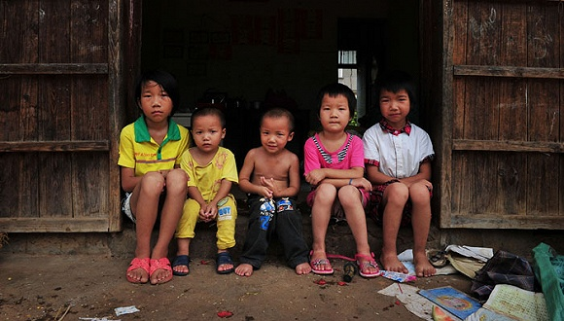
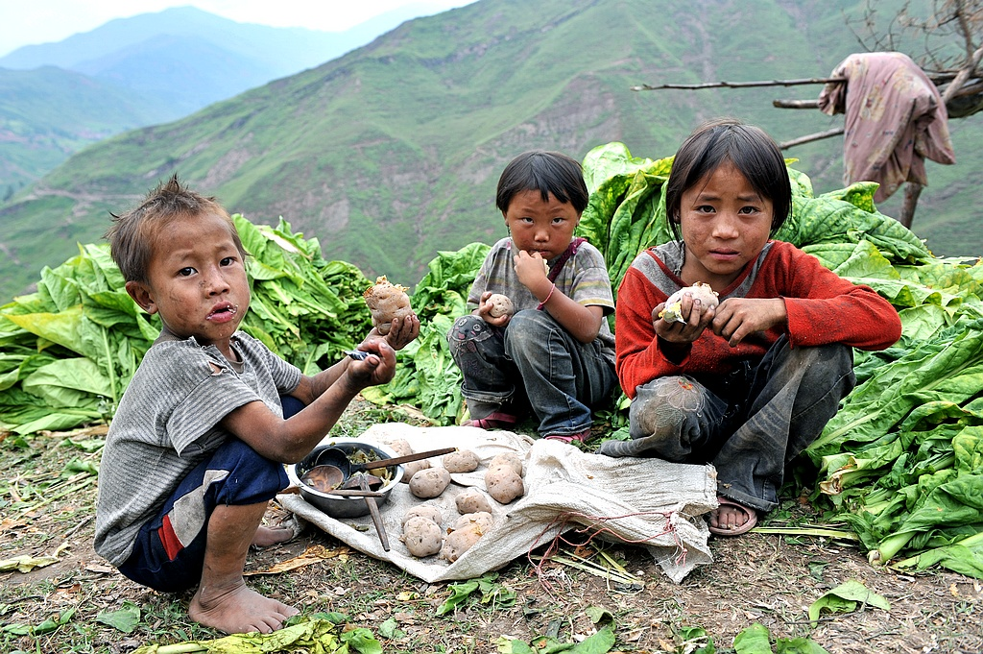
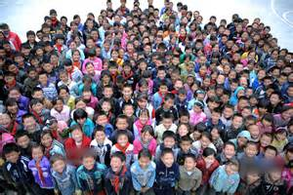

Slide 86
Background
Estimated to have 60 million left-behind children
Notes:
60 million is an old estimate by All-China federation of women. The ministry of civil affairs is try to tally the numbers now.

Slide 87
Key research questions
Why their parents migrate?
Why are they left-behind? (instead of becoming migrant children)
Effect of parental absence on their cognitive and non-cognitive development
Lots of possible outcome variables: test score; grade retention; graduation; non-cognitive measures; long-term outcomes such as jobs…
Does it matter (and to what extent) who migrated? Father vs. mother vs. both

Slide 88
How does migration affects left-behind children
Migration typically increases household income, which can finance greater investments in children
Migration experience affects parental information or attitudes regarding returns to children’s human capital
Parental absence reduces parental contact with children, which can negatively affect child development
Migration of father increases agricultural labor time of mother, reducing mother’s (or other family members’) contact time with children

Slide 89
How does migration affects left-behind children
Parental migration facilitates child migration (better job information and networks, role model effect, fewer financial barriers), influencing incentives to invest in human capital
Migration of one parent increases control of other parent over household resource allocation, which can influence investments in children
Many other possibilities, because of the interlinked nature of household decision-making

Slide 90
Major empirical challenges
Parental migration is NOT exogenous. The (unobserved) factors driven parental migration decision could affect children’s outcomes as well. The decision could also be based on (expected and realized) children’s outcomes.
Confounding factors. Change of Guardianship. Influence of grandparents, for example.
Separating Channels. Remittance. Lack of parental interactions….

Slide 91
Major empirical challenges
Parental migration is NOT exogenous.
Propensity score matching; Fixed effects (look at changes); find good IV for migration decision; RCT?
Confounding factors. Change of Guardianship. Influence of grandparents, for example.
Collecting more information. Ususally need to go from household-based survey to family-based survey
Separating Channels. Remittance. Lack of parental interactions….
Collecting more information. (directly observing remittance or change of financial resources. Direct measure of parental involvment)

Slide 92
Empirical strategies of some non-china papers
McKenzie and Rapoport (2011): IV: historic state-level migration rates
Hanson and Woodruff (2003): Mexico, IV: historic migration rates interacted with individual characteristics
Mansuri (2006): Pakistan, IV: interaction of village migration network size and number of adult men in the household
Yang (2008) finds positive effect of remittances on educational spending and enrolment in Philippines, IV: exchange rate shocks

Slide 93
Empirical strategies : China studies
Lee and park (2010): Instrument: Labor Market Shocks to Village Migration Destinations
de Brauw and Giles (2008): migration on high school enrolment in China, IV: timing of national identity card issuance, interacted with individual characteristics
Zhou, Murphy, Tao (2014); Chen et al. (2009): propensity score matching
Chang, Dong, Macphail (2011); migration on time use of children (and elderly). IV: proportion of households with migrating members in village, excluding the household.
Notes:
Chang, Hongqin, Xiao-yuan Dong, and Fiona MacPhail. "Labor migration and time use patterns of the left-behind children and elderly in rural China." World Development 39.12 (2011): 2199-2210.
Lu, Yao. "Education of children left behind in rural China." Journal of Marriage and Family 74.2 (2012): 328-341.
Chen, Xinxin, et al. "Effect of migration on children's educational performance in rural China." Comparative Economic Studies 51.3 (2009): 323-343.
Zhou, Minhui, Rachel Murphy, and Ran Tao. "Effects of parents' migration on the education of children left behind in rural China." Population and Development Review 40.2 (2014): 273-292.
Zhang, Hongliang, Jere R. Behrman, C. Simon Fan, Xiangdong Wei, and Junsen Zhang. "Does parental absence reduce cognitive achievements? Evidence from rural China." Journal of Development Economics 111 (2014): 181-195.

Slide 94
Empirical strategies : China studies
Zhang et al. (2014), GMM method after first-differencing. Lagged migration status as IV for current migration.

Slide 95
Main research findings: Mixed/Neutral
Lee and Park (2010). fathers’ migration reduces enrolment by sons, has significant positive effects on the academic outcomes of daughters. has negative effects on the psychosocial well-being of both boys and girls.
Chen et al. (2009). no significant negative effect of migration itself on the children’s school performance. in some cases (e.g., after the father migrates), performance improves.
Lu (2012). Migration of siblings generates benefits for children’s education, which is particularly pronounced for girls and children at middle-school levels. But parental migration has not given children left behind a significant advantage in educational prospects as their parents had hoped. Younger children seem to be especially susceptible to the disruptive effect of parental out-migration.

Slide 96
Main research findings: Negative
McKenzie and Rapoport (2011). family migration depresses educational attainment. (children’s migration)
de Brauw and Giles (2008). a robust negative relationship between migrant opportunity and high school enrollment. local and migrant non-agricultural employment of high school age young adults as the size of the current village migrant network increases.
Zhou, Murphy, Tao (2014). children’s Chinese and mathematics test scores are significantly lower only when both parents have migrated, while the migration of one parent has little effect.
Chang, Dong, Macphail (2011). the migration of household members increases the time spent on farm work and domestic work by the left-behind elderly and children. Females affected more.
Zhang et al. (2014). significant negative impacts of being left-behind by both parents on children's cognitive development, reducing their contemporary achievements by 5.4 percentile points for math and 5.1 percentile points for Chinese, but much smaller insignificant impacts of being left-behind by one parent.

Slide 97
Main research findings: Positive
Hanson and Woodruff (2003). Children in migrant households complete significantly more years of schooling, especially for girls from poor families. (relaxing credit constraint).
Mansuri (2006). positive effects of temporary economic migration on human capital accumulation are large, especially for girls. the gains appear to arise almost entirely from the greater resource flows to migrant households.
Yang (2008). Positive migrant shocks lead to enhanced human capital accumulation and entrepreneurship in origin households. Child schooling and educational expenditure rise, while child labour falls.

Slide 98
What to do next?
Better identification strategy
More outcomes (especially long term outcomes)
Better understanding the determinants of their left-behind situation (collect information on extended family members)

Slide 99
What to do next?
Left-behind vs. migrant children
existing studies: left-behind children vs. children with parents in village
other possible comparison: left-behind children vs. migrant children (in both cases conditional on parental migration)
This is more challenging as we need to collect data on both left-behind children and migrant children. But it’s a very policy-relevant comparison!

Slide 100
What to do next?
Identify good measures of remediation (assuming they have to remain left-behind).
boarding school; after-class tutoring; psychological intervention; …..

Slide 101
Reference
Chang, Hongqin, Xiao-yuan Dong, and Fiona MacPhail. "Labor migration and time use patterns of the left-behind children and elderly in rural China." World Development 39.12 (2011): 2199-2210.
Chen, X., Huang, Q., Rozelle, S., Shi, Y., & Zhang, L. (2009). Effect of migration on children's educational performance in rural China. Comparative Economic Studies, 51(3), 323-343.
De Brauw, Alan, and John Giles. "Migrant opportunity and the educational attainment of youth in rural China." World Bank Policy Research Working Paper Series, Vol (2008).
McKenzie, David, and Hillel Rapoport. "Can migration reduce educational attainment? Evidence from Mexico." Journal of Population Economics 24.4 (2011): 1331-1358.
Hanson, Gordon H., and Christopher Woodruff. Emigration and educational attainment in Mexico. Mimeo., University of California at San Diego, 2003.
Lee, Leng, and Albert Park. "Parental migration and child development in China." (2010).
Lu, Yao. "Education of children left behind in rural China." Journal of Marriage and Family 74.2 (2012): 328-341.
Mansuri, Ghazala. "Migration, school attainment, and child labor: evidence from rural Pakistan." World Bank Policy Research Working Paper 3945 (2006).
Yang, Dean. "International migration, remittances and household investment: Evidence from philippine migrants’ exchange rate shocks*." The Economic Journal 118.528 (2008): 591-630.
Zhang, Hongliang, Jere R. Behrman, C. Simon Fan, Xiangdong Wei, and Junsen Zhang. "Does parental absence reduce cognitive achievements? Evidence from rural China." Journal of Development Economics 111 (2014): 181-195.
Zhou, Minhui, Rachel Murphy, and Ran Tao. “Effects of parents‘ migration on the education of children left behind in rural China.” Population and Development Review 40.2 (2014): 273-292.

Slide 102
The road ahead

Slide 103
Key research questions
Long run impacts (of attending migrant schools; of being left-behind)
Life-cycle of migrating and returning
More understanding of key decisions (migration; migration with/without children)
How do children’s educational opportunities affect migration decisions

Slide 104
Data collection initiatives
Two related to IESR
http://iesr.jnu.edu.cn/
RUMiC (https://www.rse.anu.edu.au/research/centres-projects/rural-urban-migration-in-china-and-indonesia/
http://iesr.jnu.edu.cn/home/rumic)
Migration and Child Development Survey

Slide 105
Some recent development and policy
Since 2014, population control in big cities (especially Beijing and Shanghai) made migrants much more difficult to stay in those destination areas
Local government need to realize that the full cost of not providing education to migrant children far more outweighs the short term benefit.

